Slide 1

Notes:
Say we have an dataset, where each entry contains some unstructured data and a set of associated structured attributes.
Here, we are seeing conference papers as examples.

Slide 2

Notes:
We can generate an embedding vector for the unstructured data and do efficient NN queries on them. But how do we combine the index for the vectors and the index for the structured attributes.

Slide 3
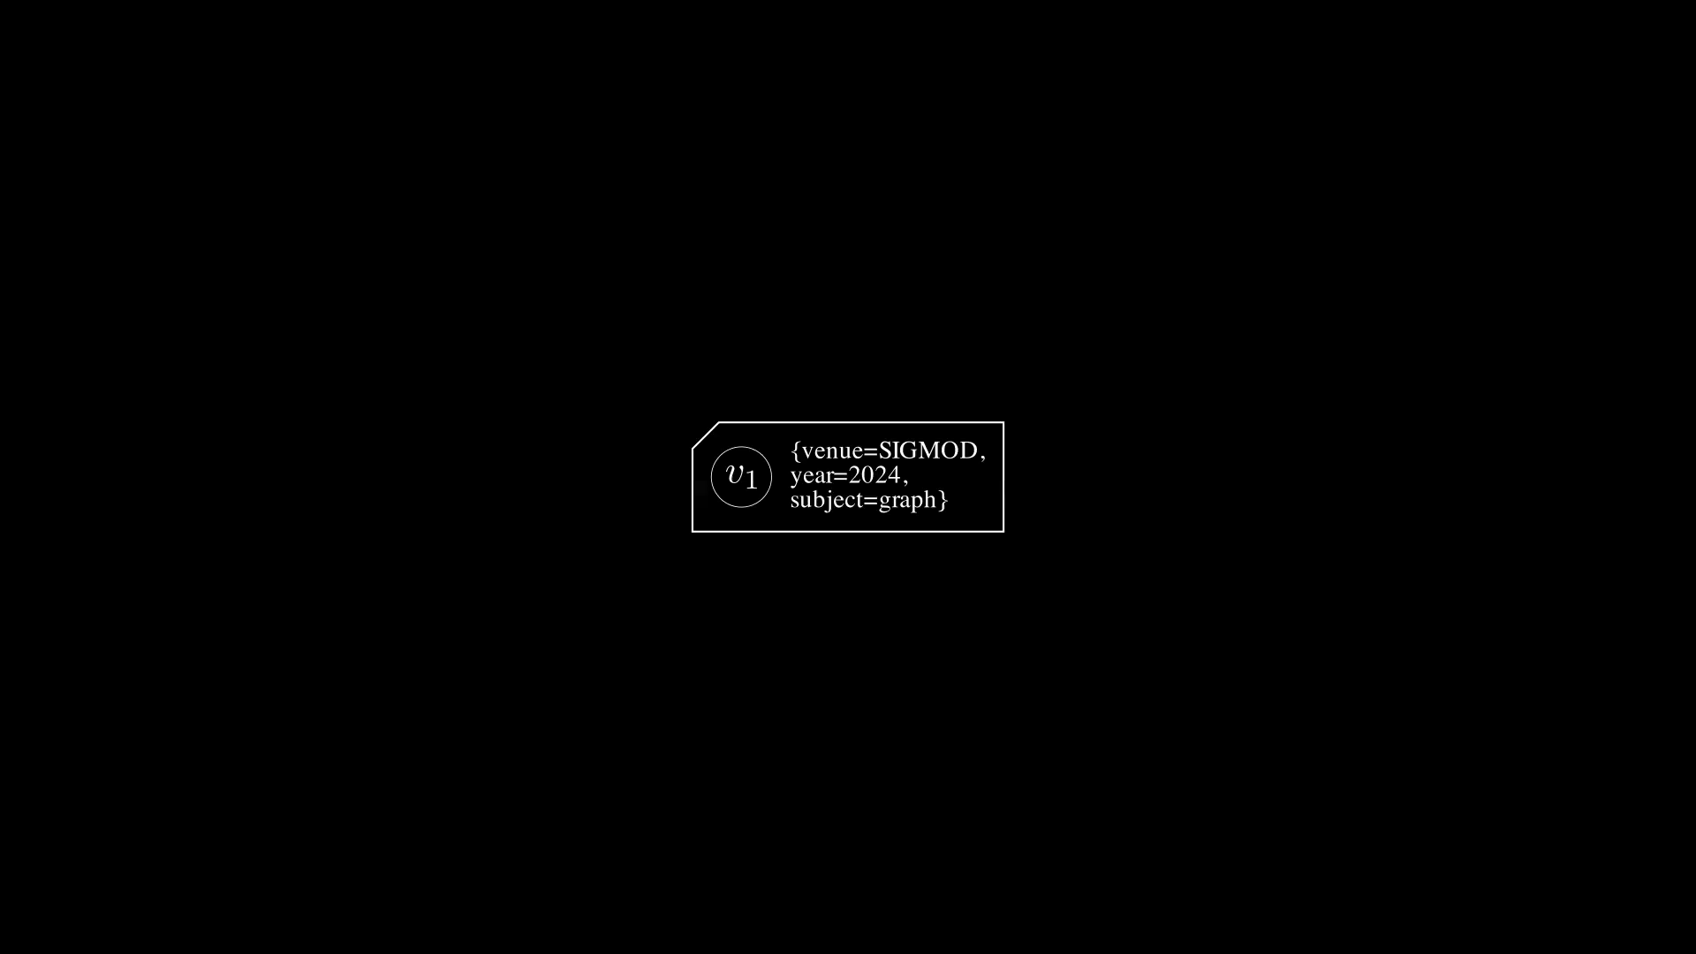
Notes:
Now the paper's insight is to define an abstraction called label.

Slide 4
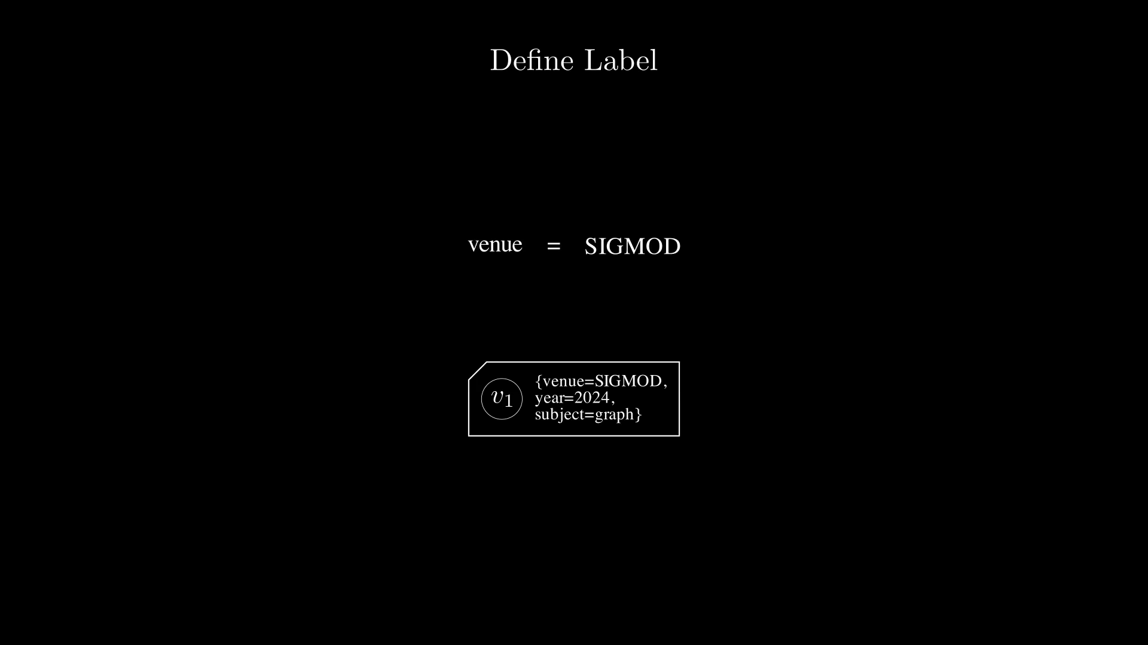
Notes:
Notice, each attribute has an attribute name and it's value assignment.

Slide 5
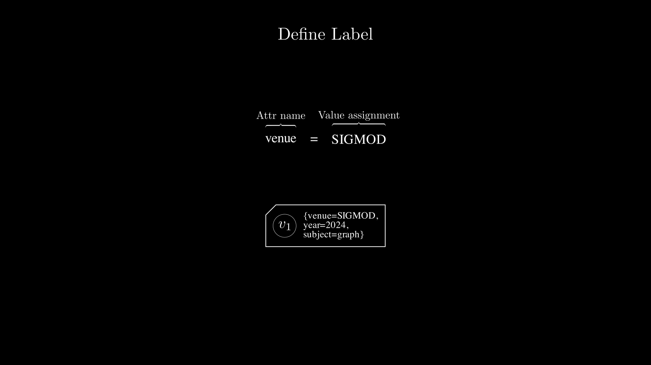
Notes:
Combined, we call each of such attribute assignment in the dataset an label.
And it's easy to show that there are finite numbers of labels in a dataset with only discrete data types, upper bounded by the length of the Cartesian Product between all attribute names and all value assignments.

Slide 6
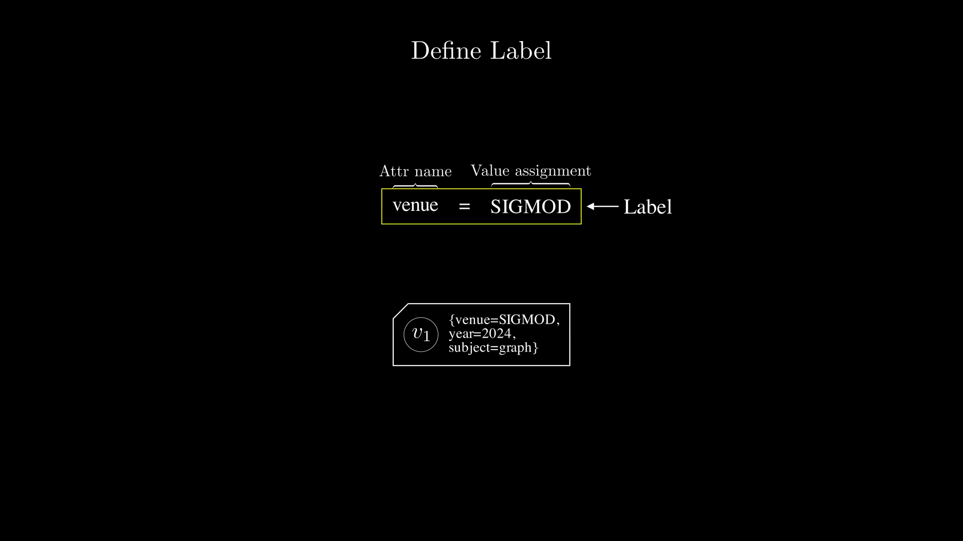
Notes:
In this presentation, I am going to show a label as this colored rectangle thingy to represent notation visually.
And if two labels has the same color, it means they have the same attribute name.
And if two labels has different color, it means they have the different attribute name.
The attribute value assignment is displayed in the center.

Slide 7
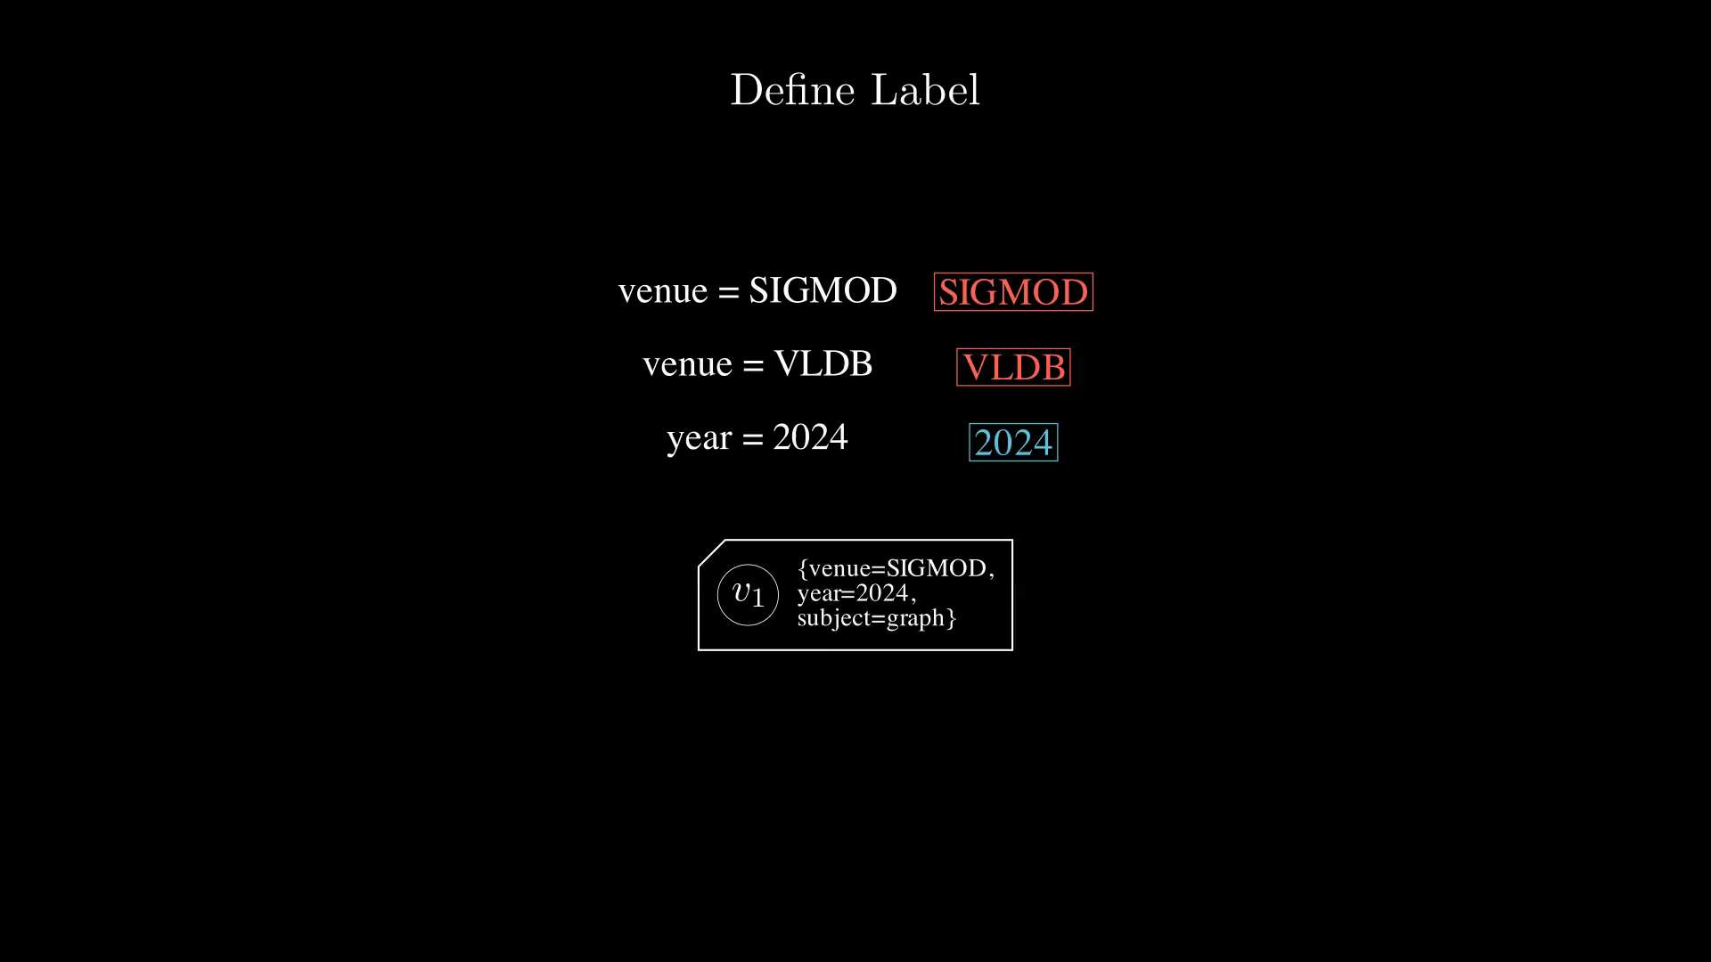
Notes:
Now let's represent the entries attribute with the labels.

Slide 8
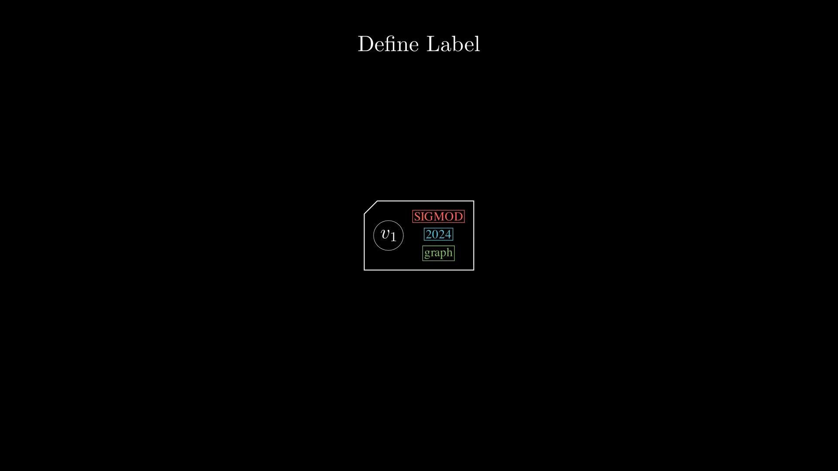
Notes:
Let's now put everything together. Here we have the embedding vectors.

Slide 9
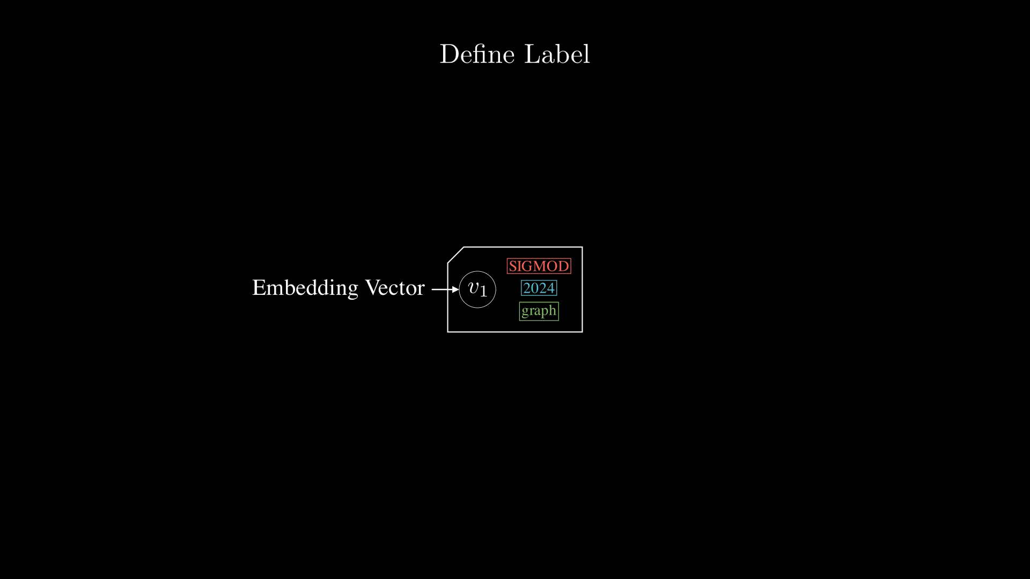
Notes:
Let's now put everything together. Here we have the embedding vectors.
And the labels.

Slide 10
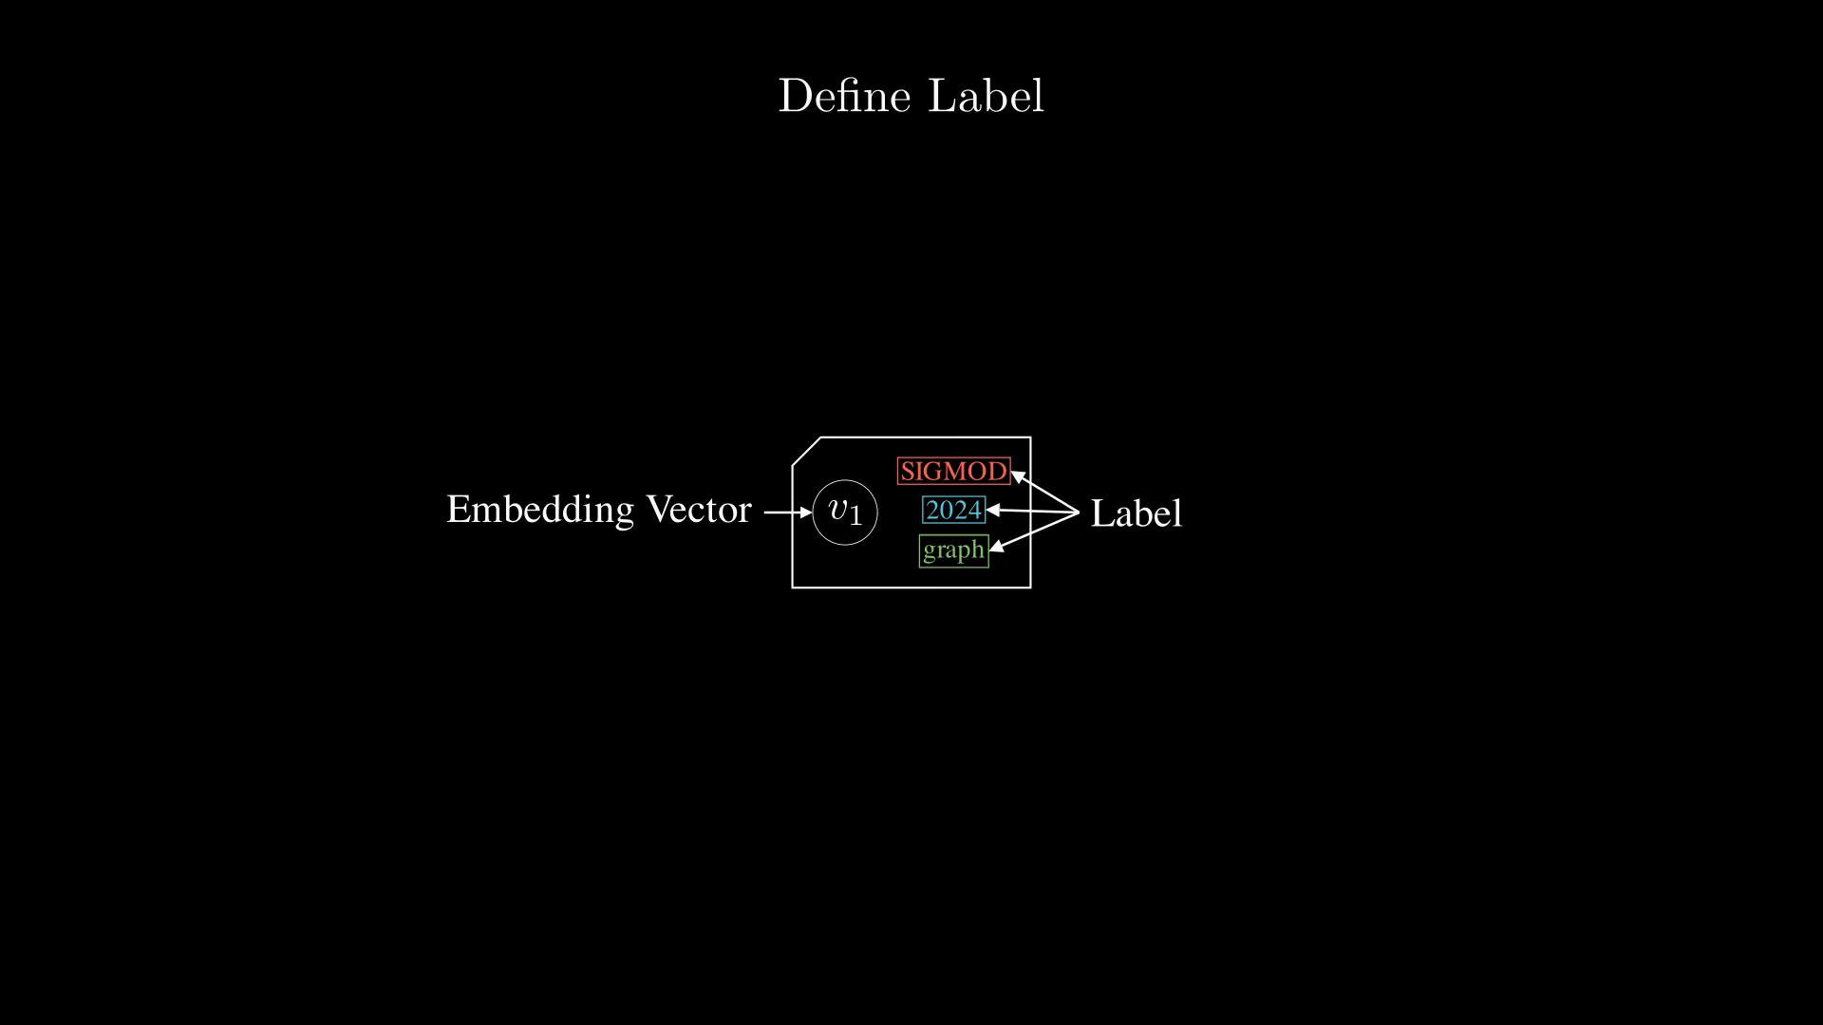
Notes:
Then we define the label set of an entry as the sets of it's label.

Slide 11
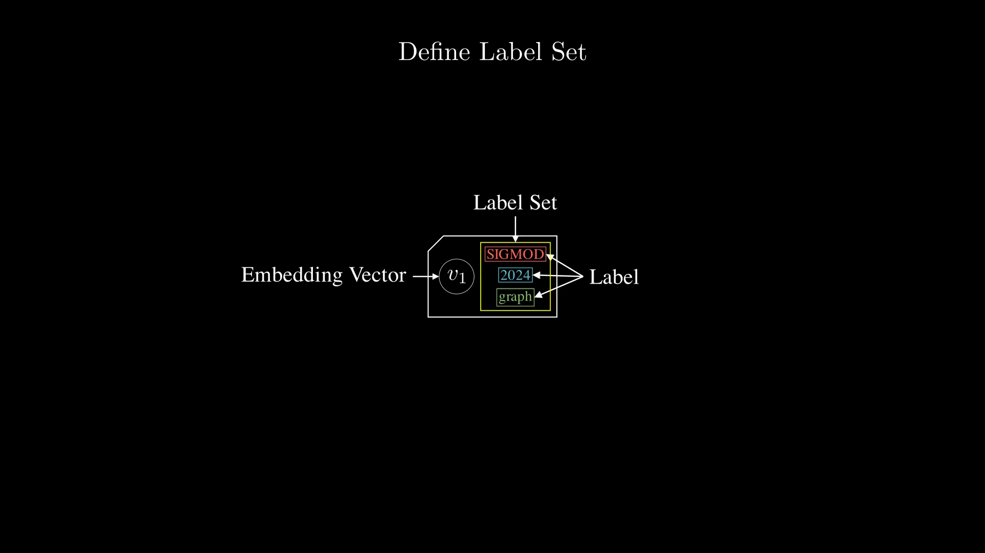
Notes:
Now let's consider all entries in the dataset, each entry have a corrosponding label set according to our definition.

Slide 12
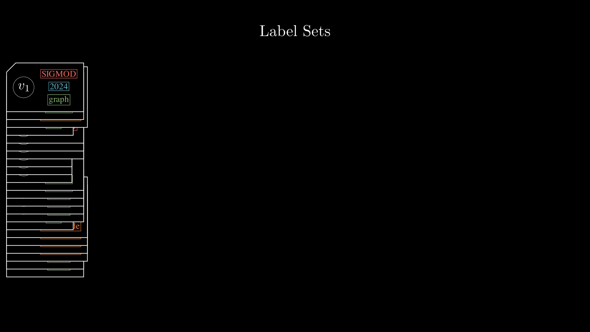
Notes:
Here are all the unique label sets in our dataset.

Slide 13
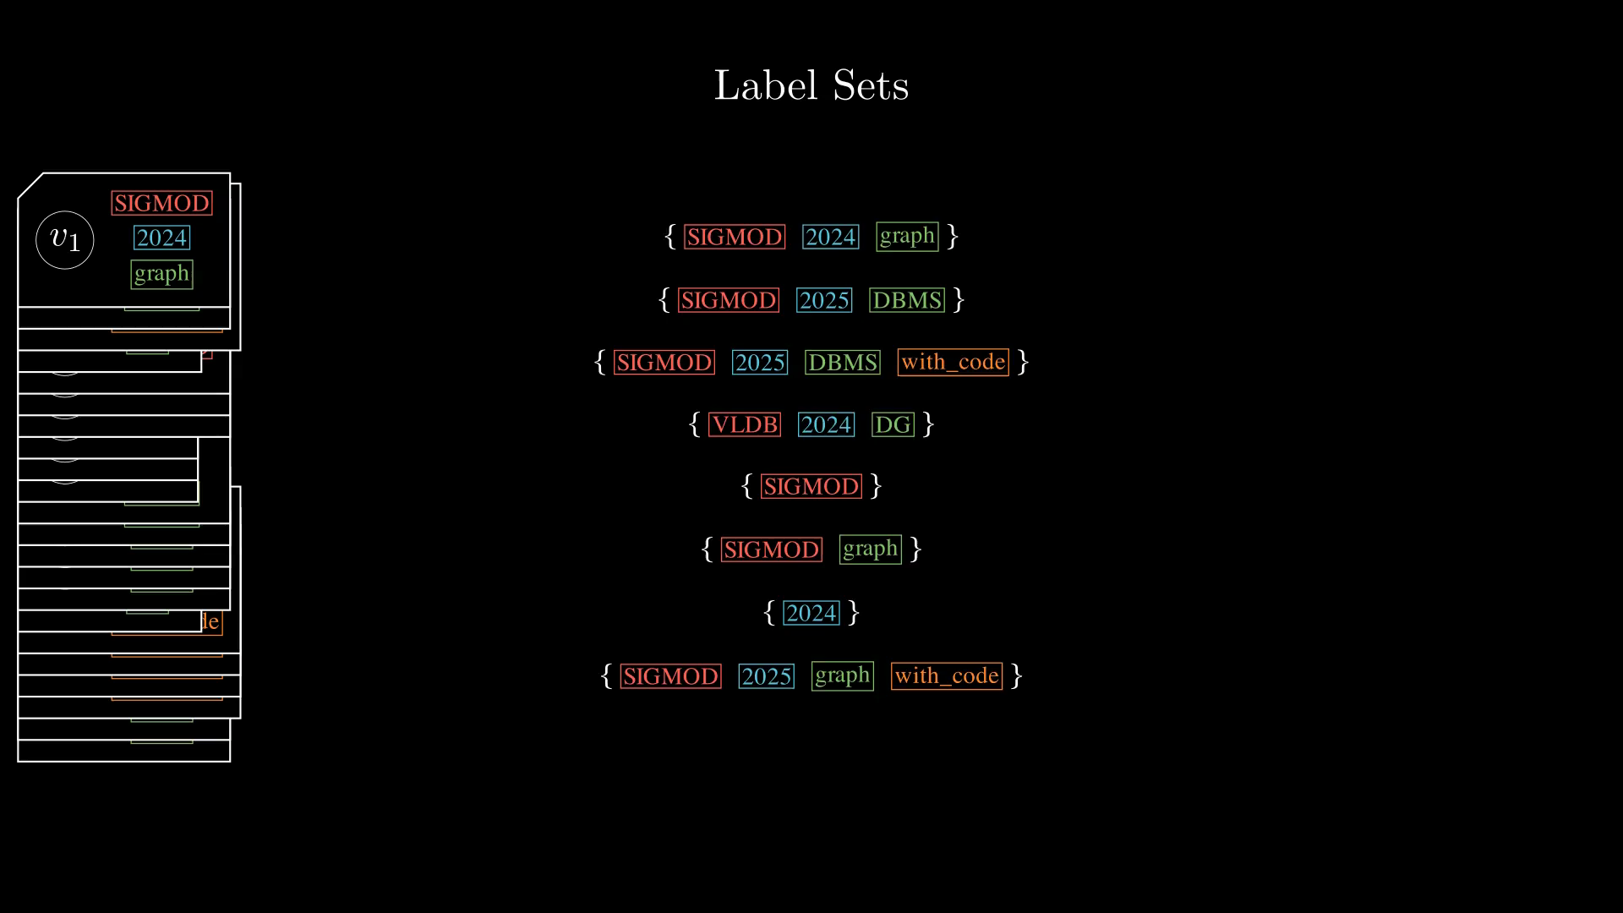
Notes:
Next, let's group the vectors by the unique label sets.

Slide 14
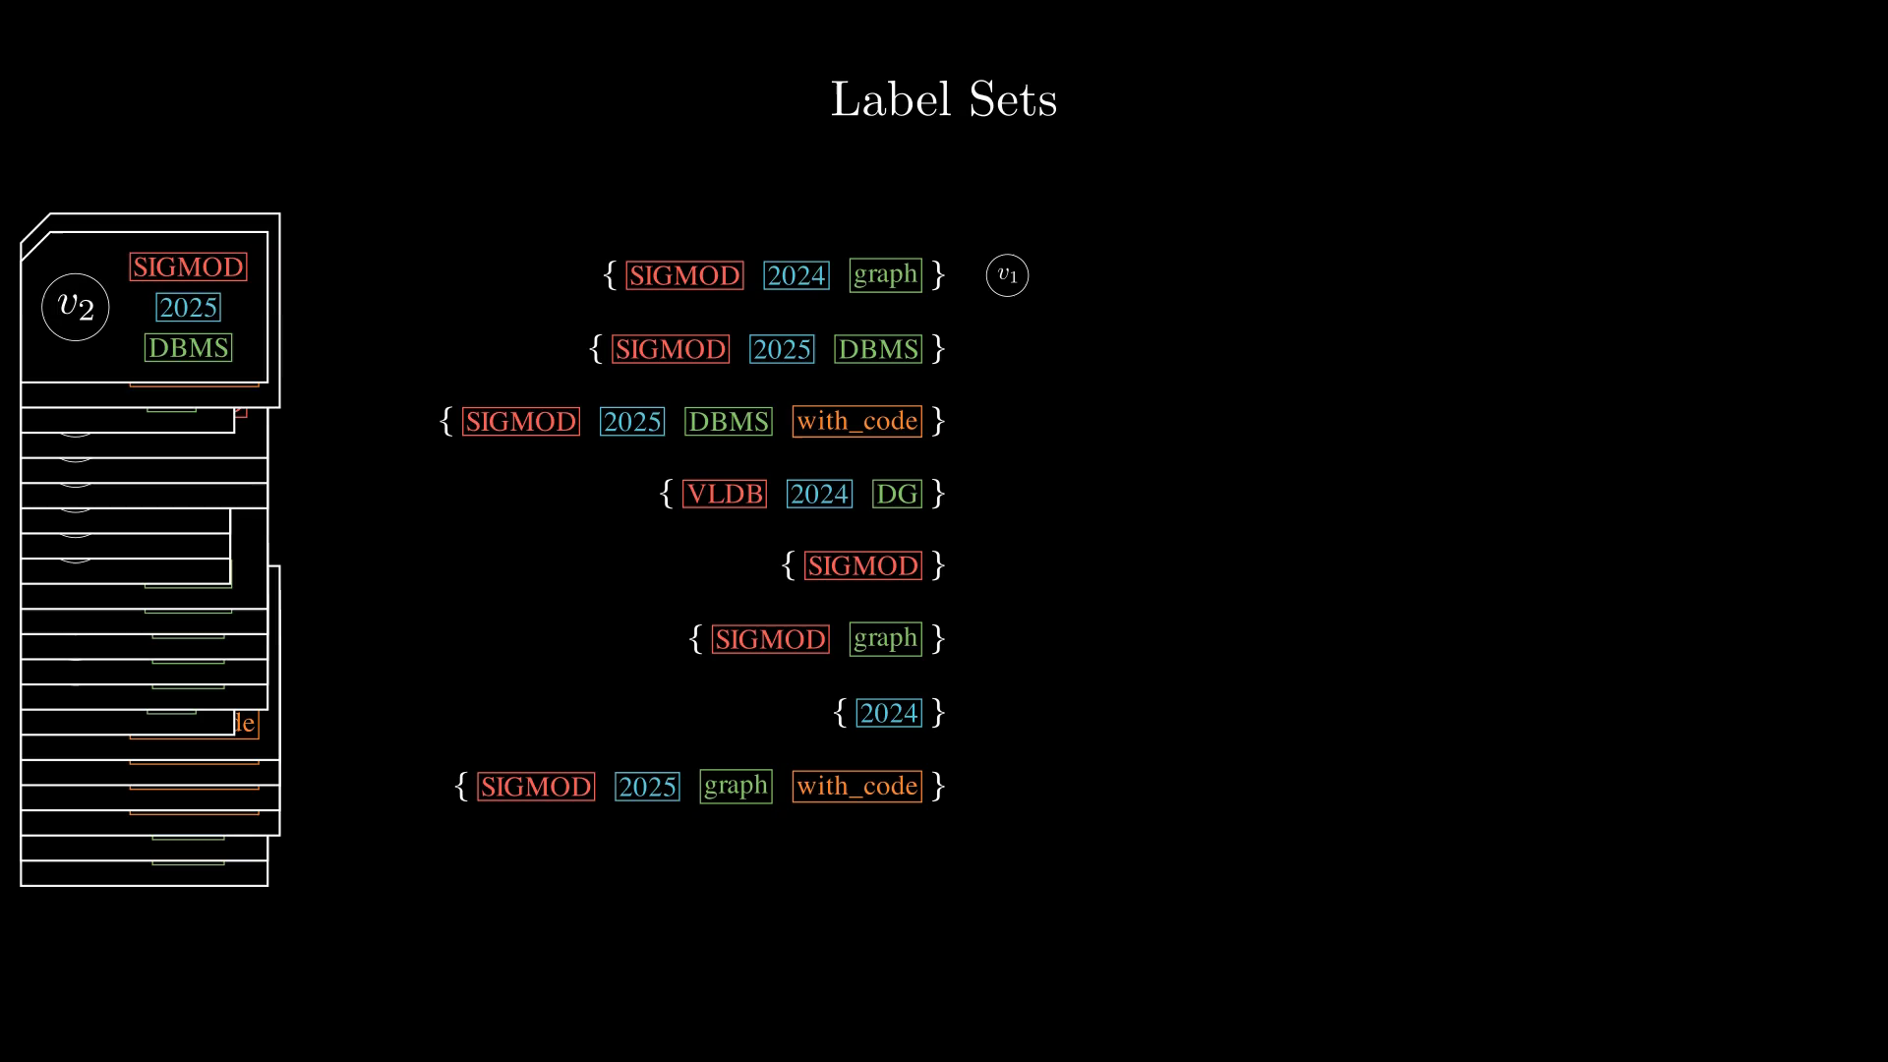
Notes:
Next, let's group the vectors by the unique label sets.

Slide 15
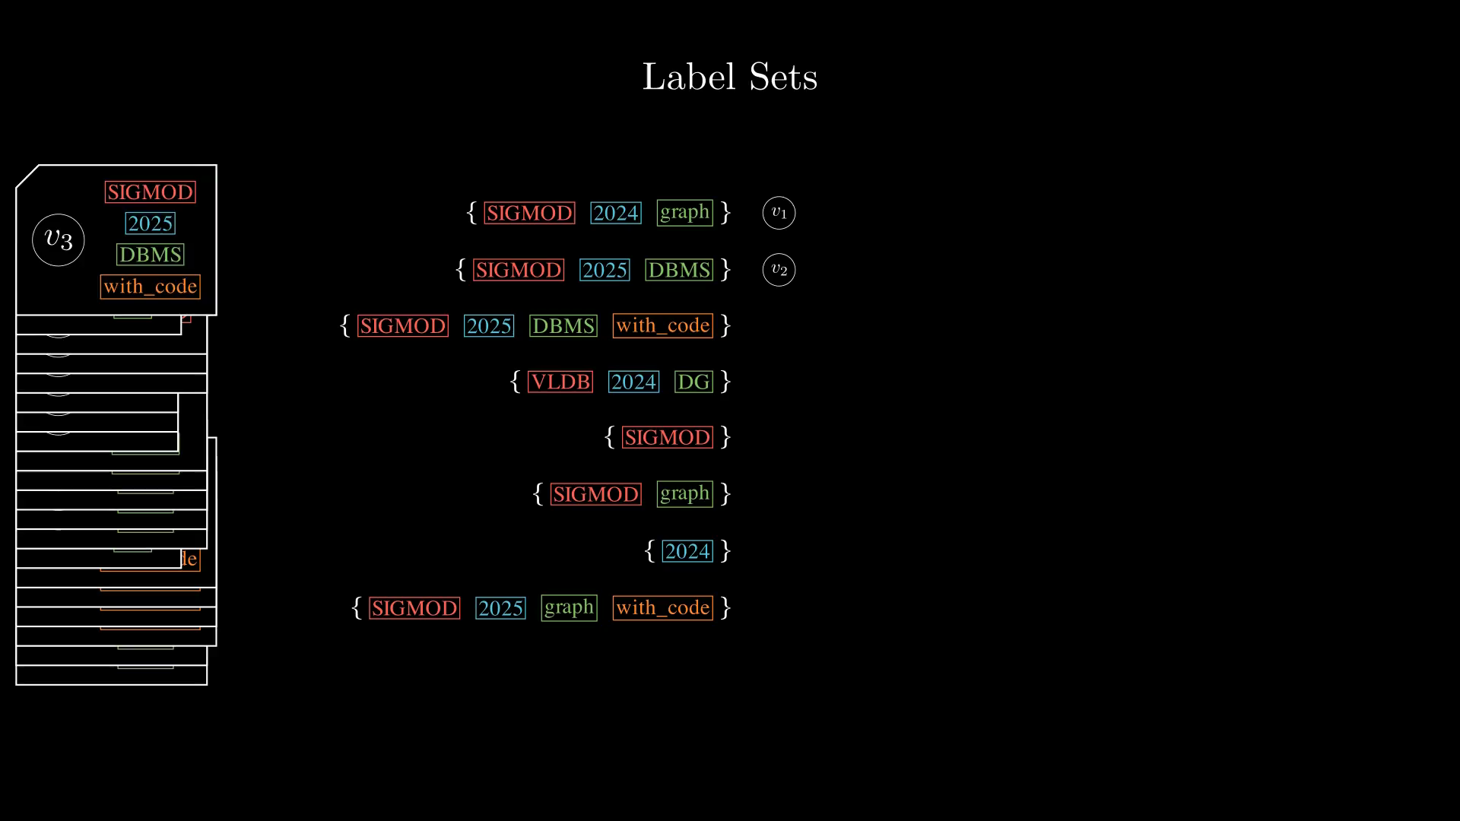
Notes:
Next, let's group the vectors by the unique label sets.
Notice that each vector have a unique label set, so this essentially allows us to partition the dataset into sets of vectors that are disjoint, where each label set owns a unique partition.

Slide 16
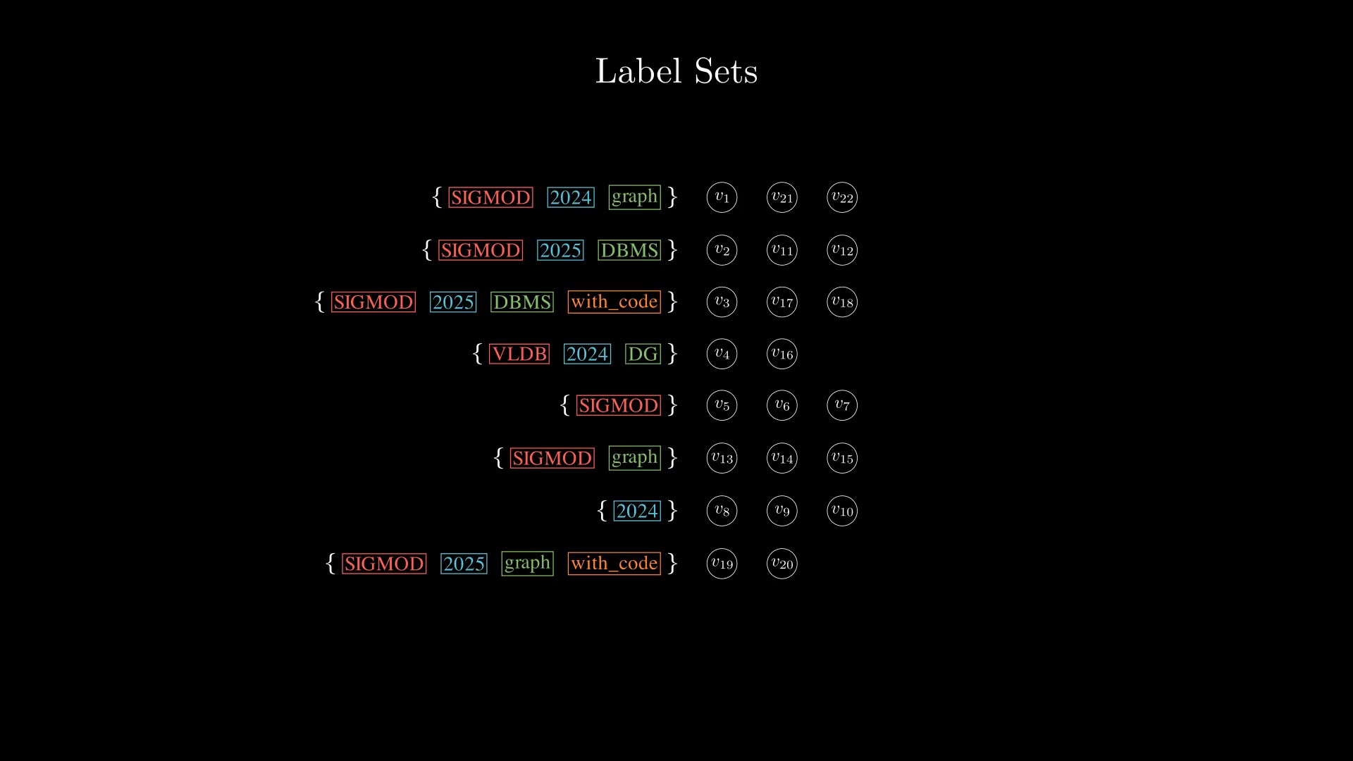
Notes:
Now, let's focus on the label sets.

Slide 17
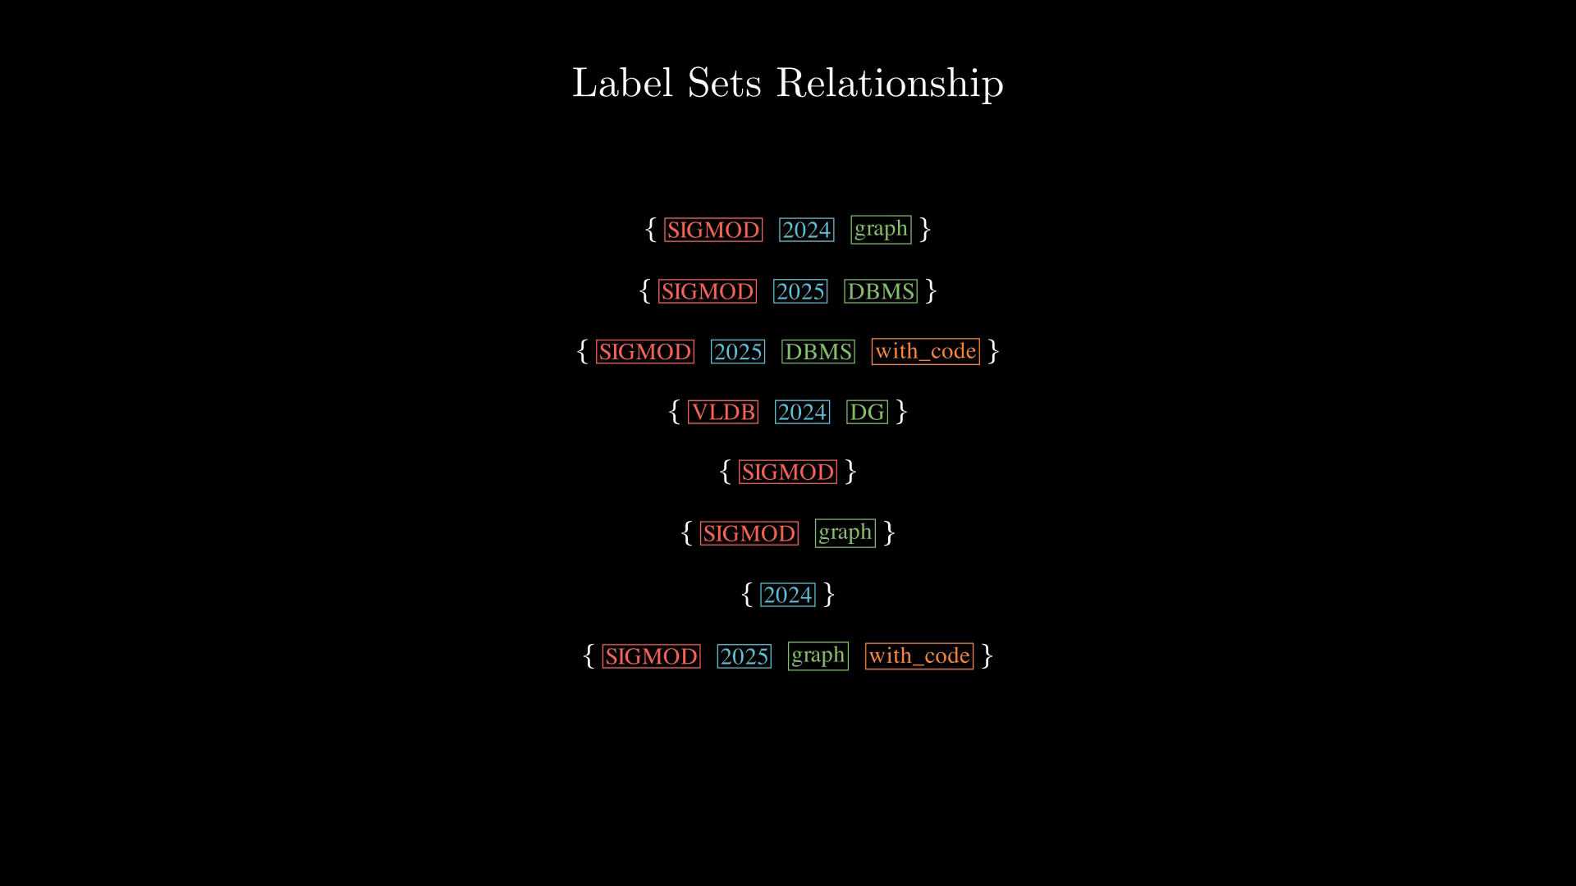
Notes:
More specifically, these three label sets...
Does anyone notices anything related to those sets?

Slide 18
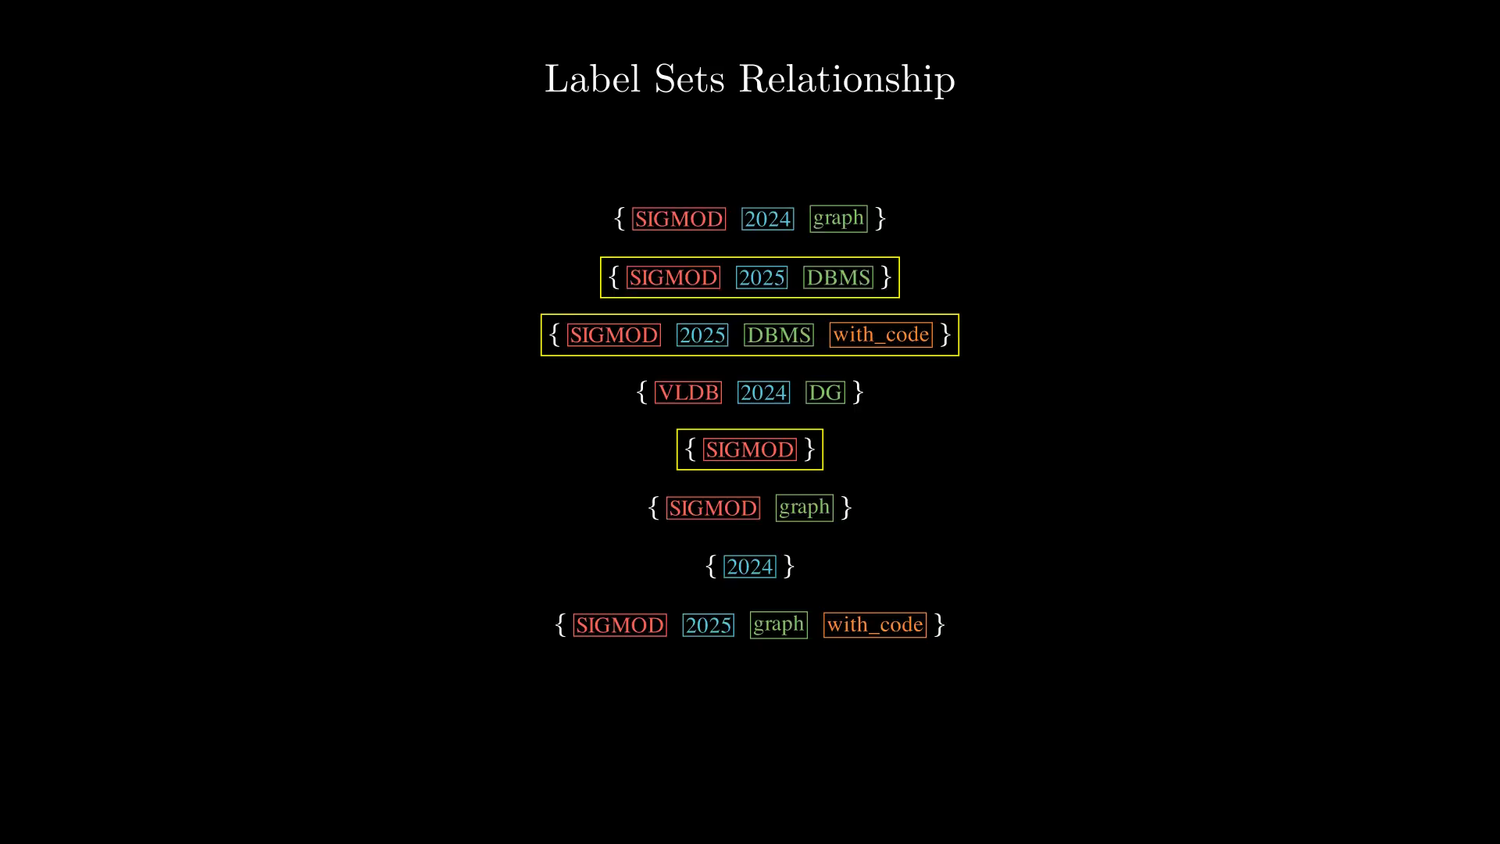
Notes:
More specifically, these three label sets...
Does anyone notices anything related to those sets?
Let's zoom in on those.

Slide 19
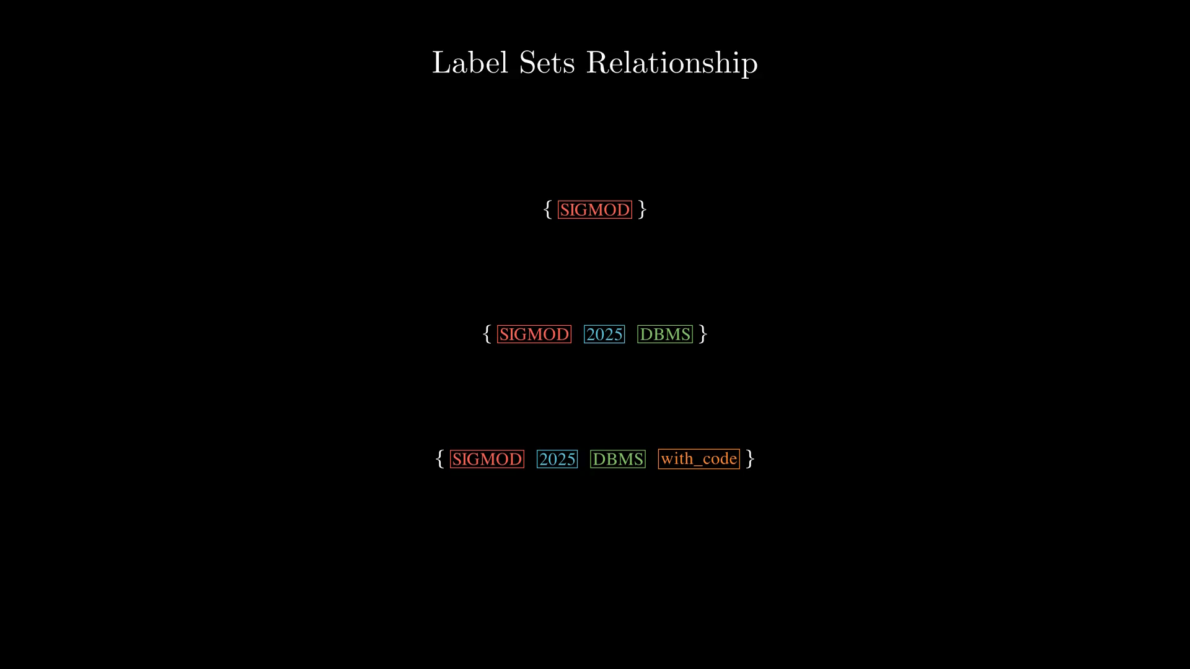
Notes:
There are some set containment relationships between them, or supersets.
Note that, what this really means is that some entries in the dataset have missing attribute values...

Slide 20
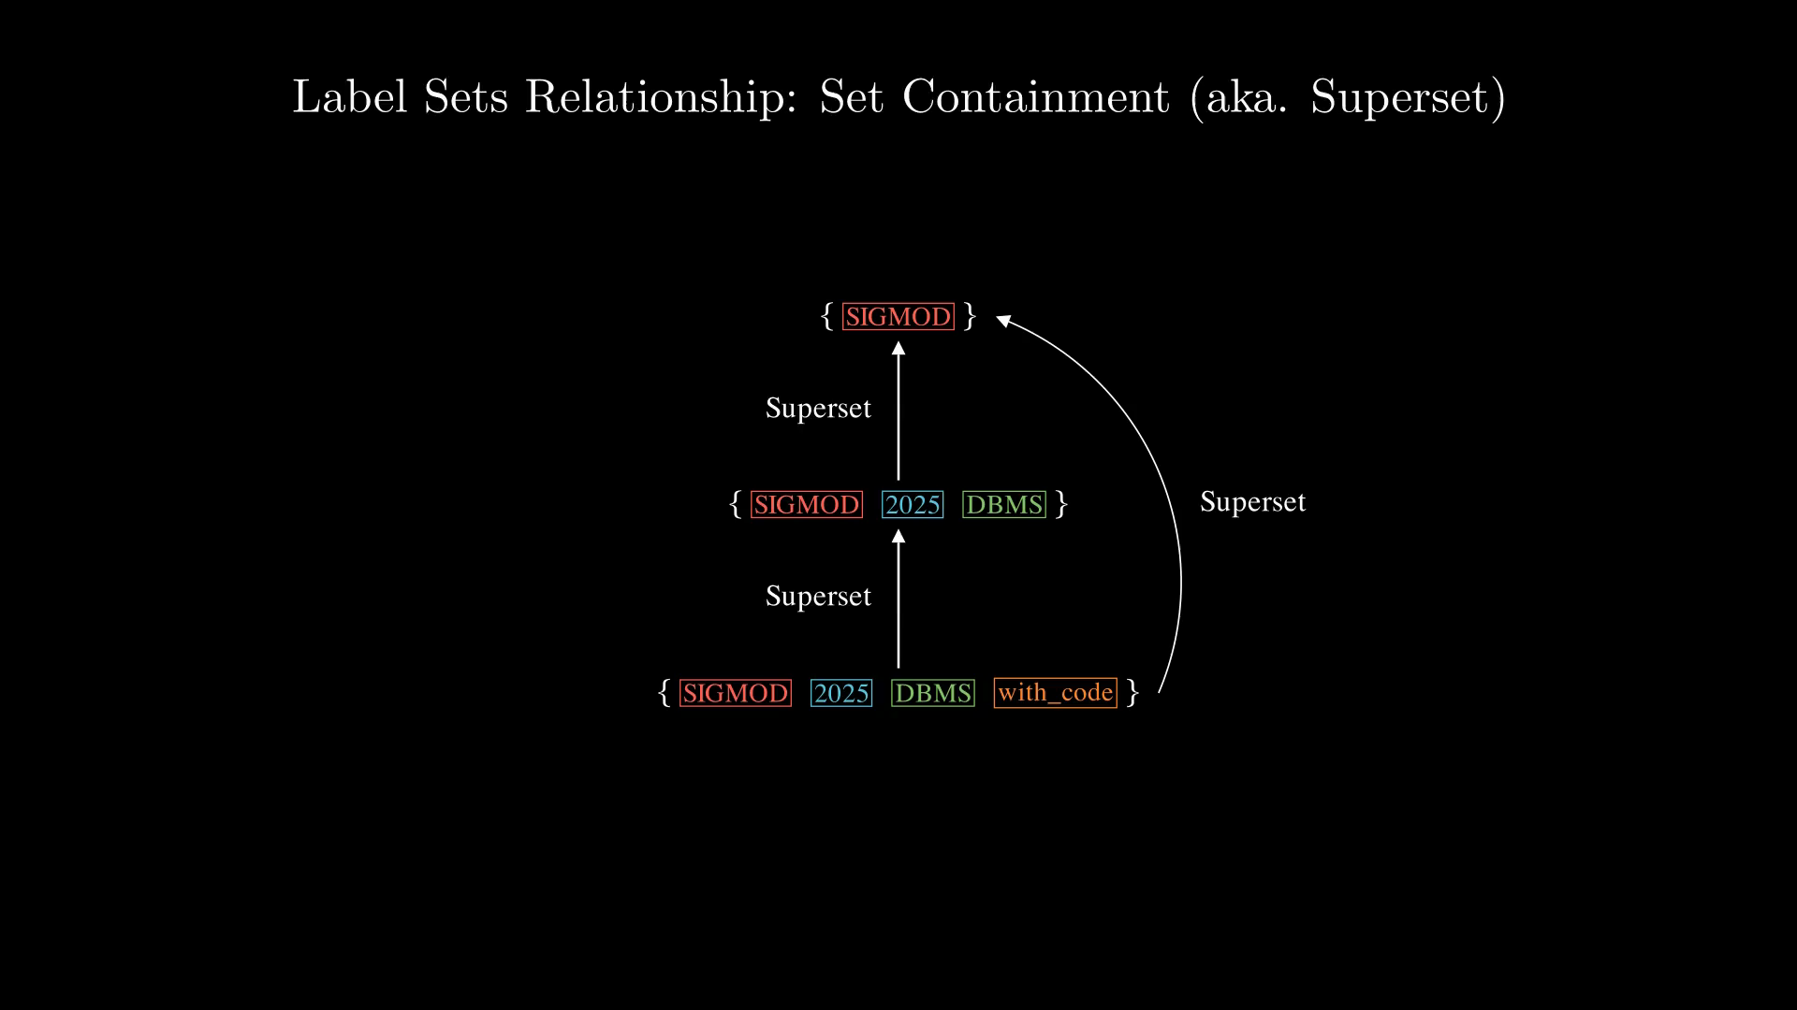
Notes:
The paper focuses on the minimum supersets, which are defined as the supersets pairs that doesn't have another superset in between of them.
Show example...

Slide 21
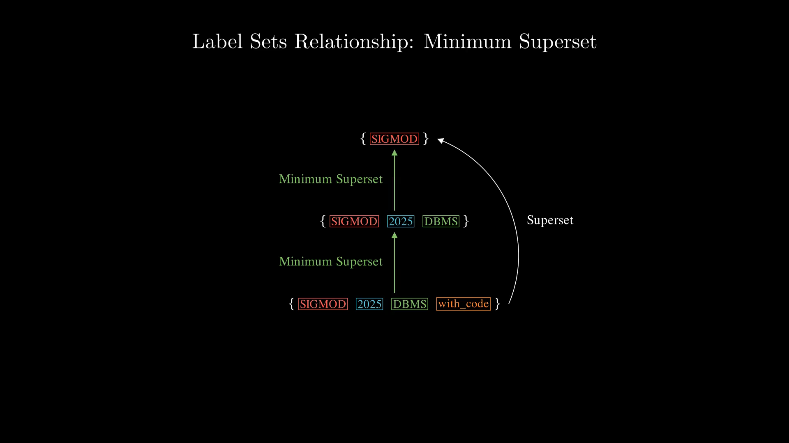

Slide 22
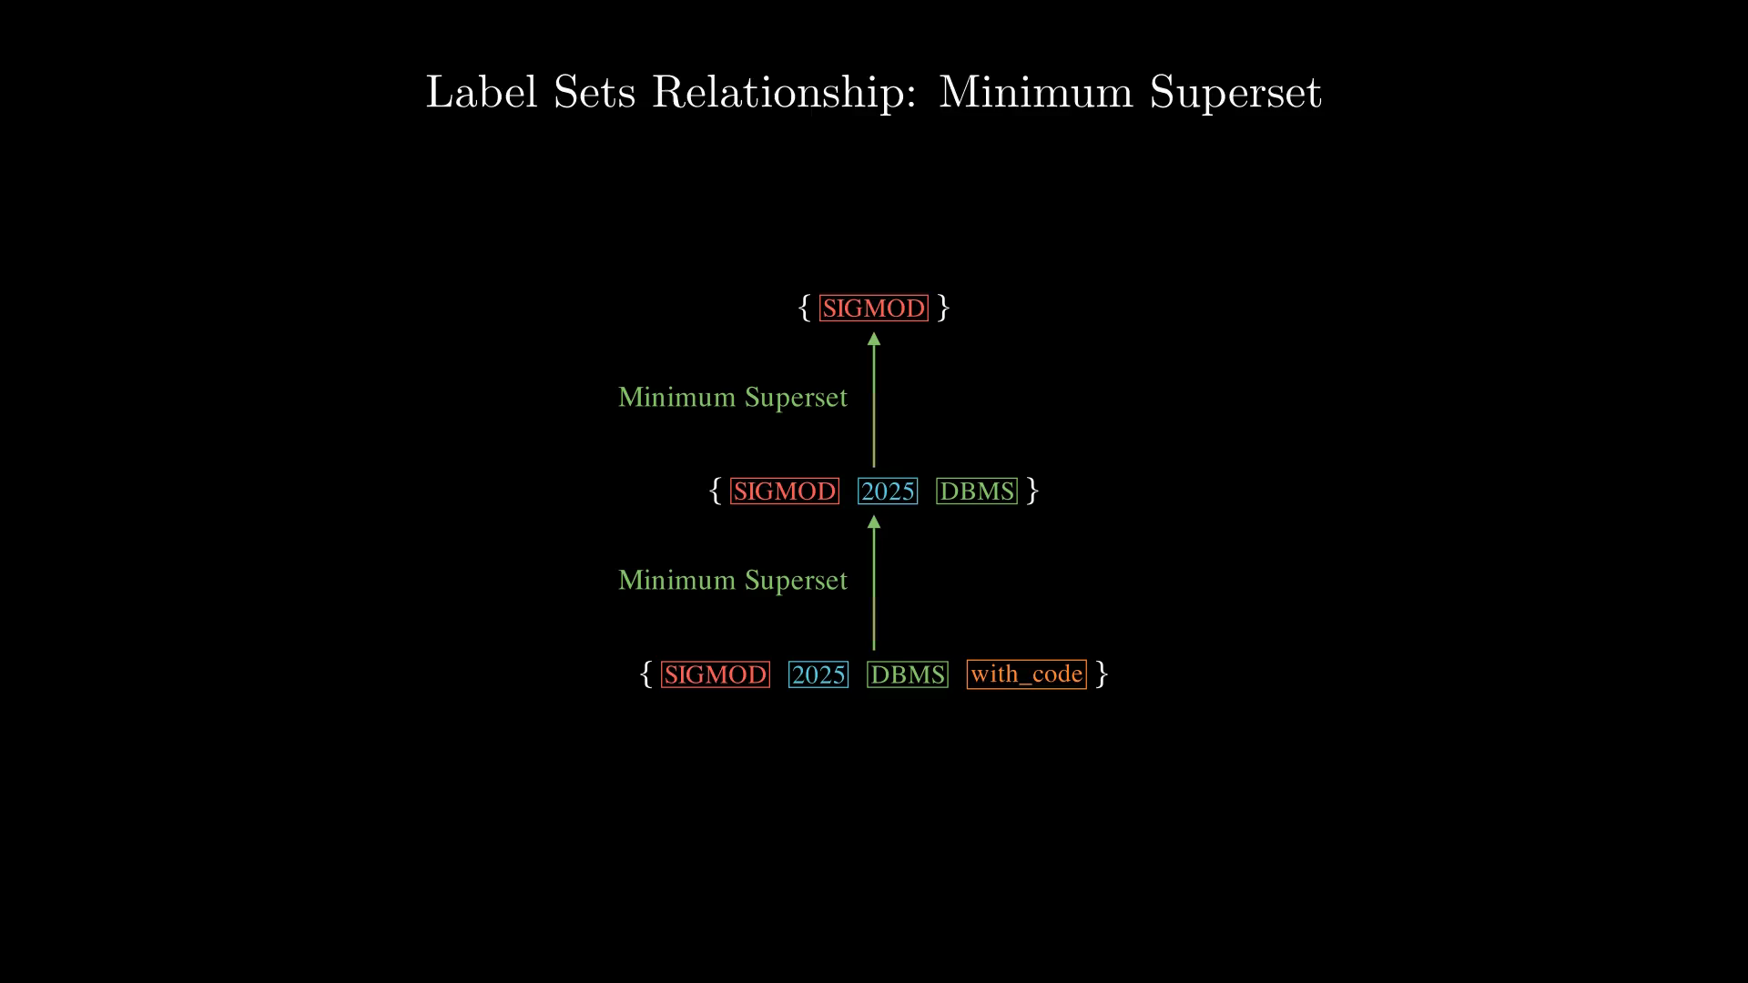
Notes:
Given that, let's now define Label Navigating Graph, which is also the paper's core intuition. Here are all the label sets.

Slide 23
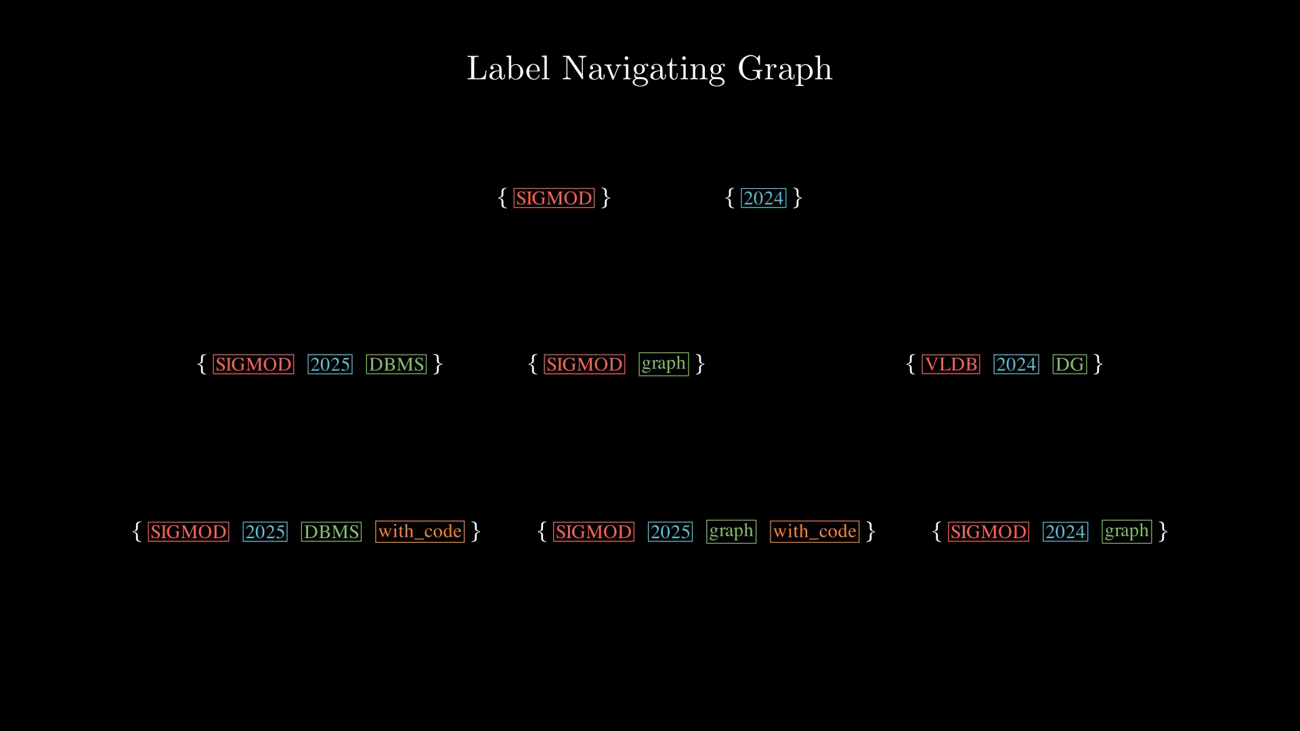
Notes:
These three are the label sets that we have seen in previous example.

Slide 24
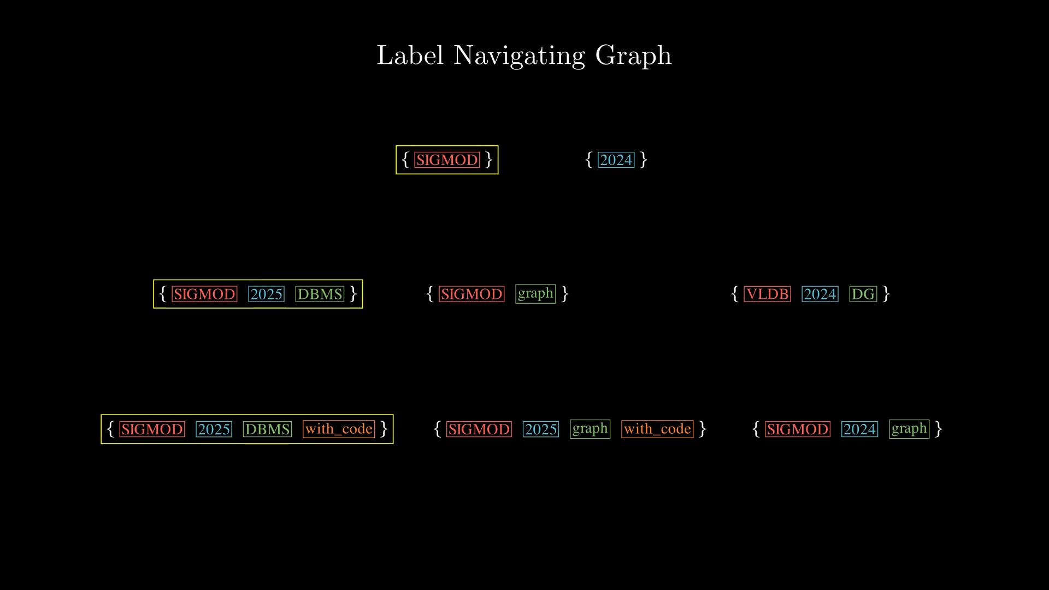
Notes:
Recall that, here are the minimum supersets relationships for them.

Slide 25
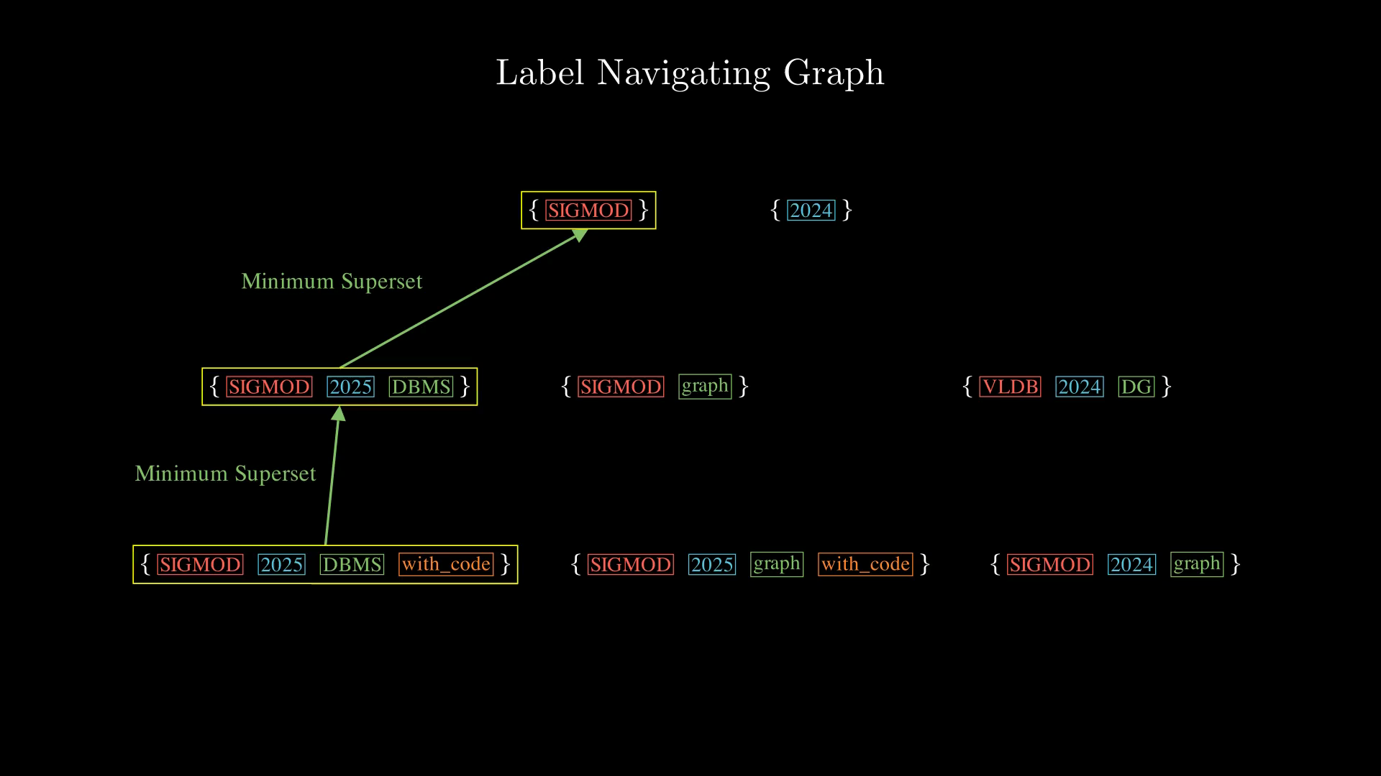
Notes:
Let's add in the minimum superset relationships for the rest of the label sets.

Slide 26
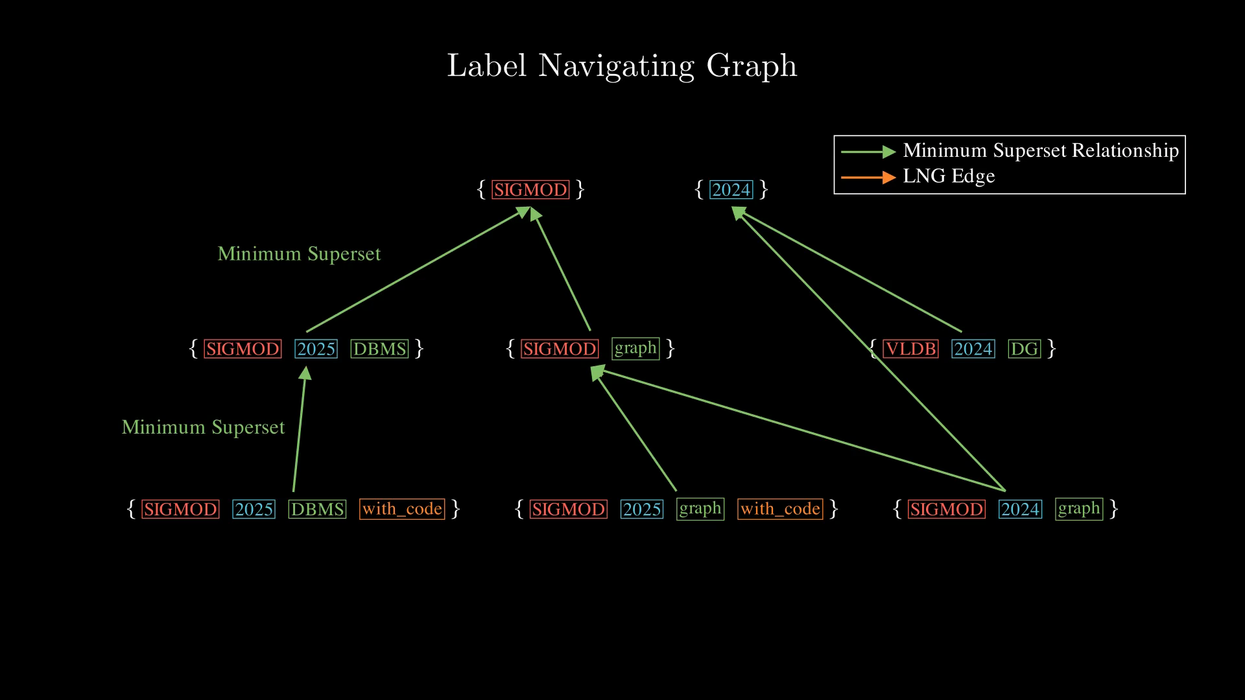
Notes:
Now, we are going add edges in the LNG graph according to the minimum superset relationship.
More specifically, we want to add edges in the reverse direction of minimum superset relationship between two label sets, so from the subset to it's supersets.

Slide 27
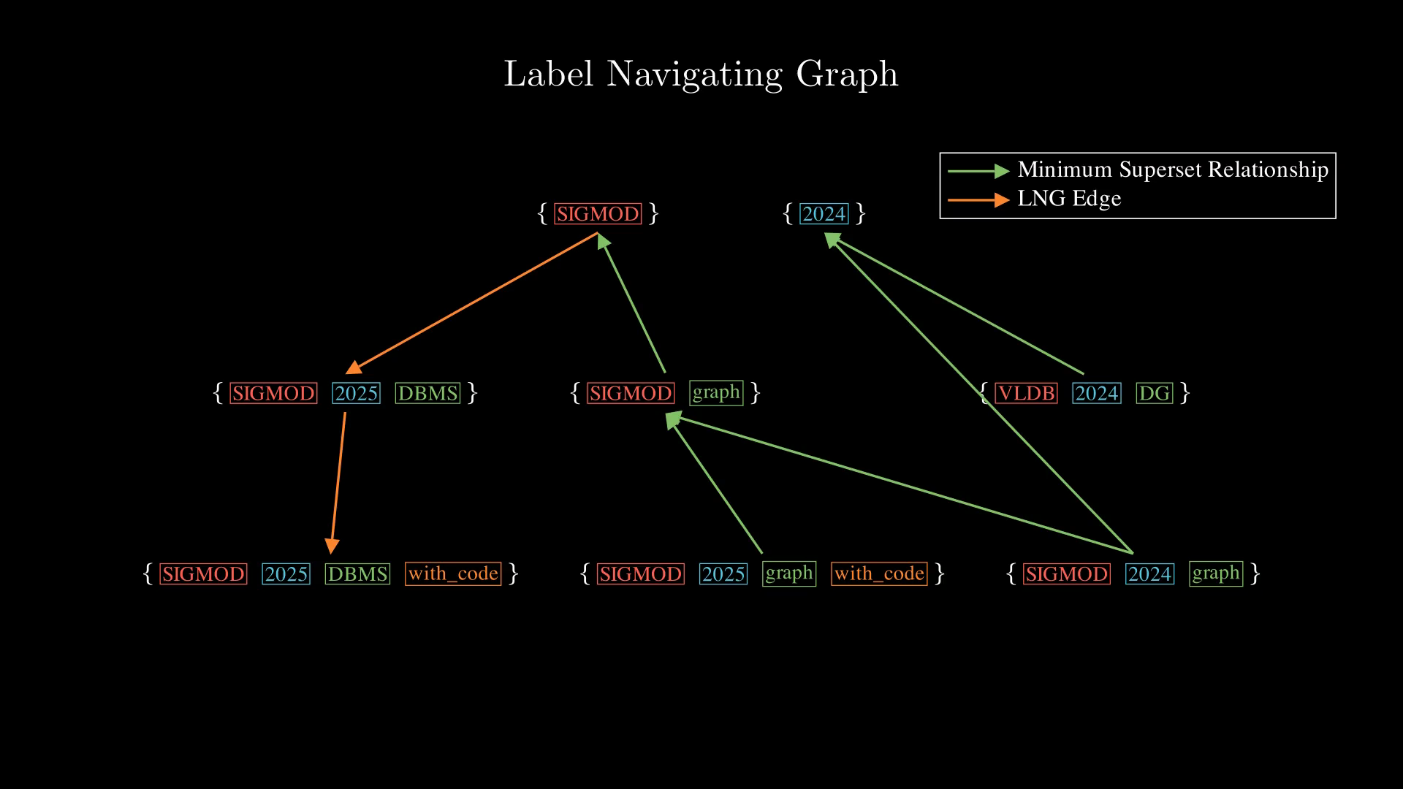
Notes:
Let's do that for all label sets, and here are the result.

Slide 28
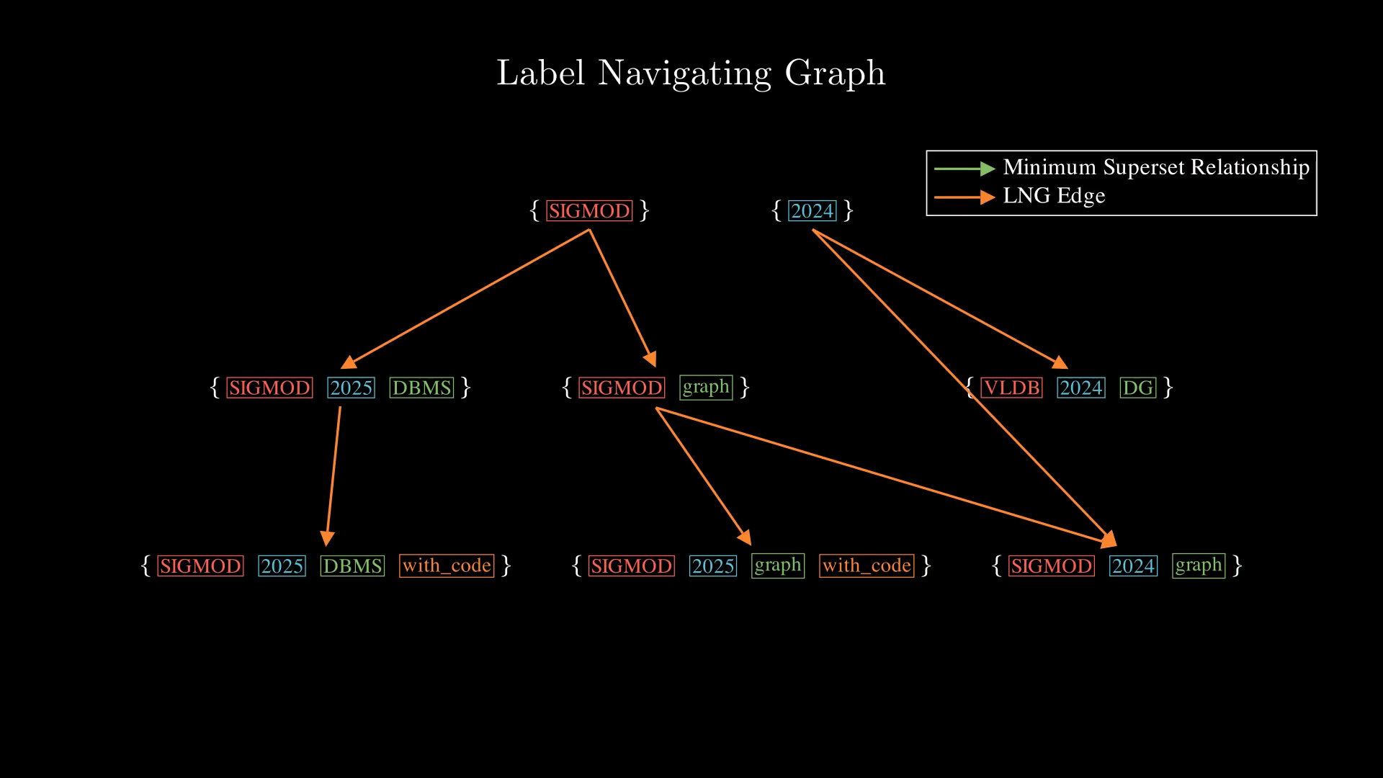
Notes:
Here, I want to highlight one important property of the LNG graph, which is that if we start from any node in the LNG graph, all the node that we can reachare supersets of the starting node.
Well this is trivial given how we constructed the graph, the edges always points to supersets.
This is related to how the paper meet the fidelity requirement we talked before.
So by starting from a label set that meets the query label set, all nodes we can reach also preserves the query filter.

Slide 29
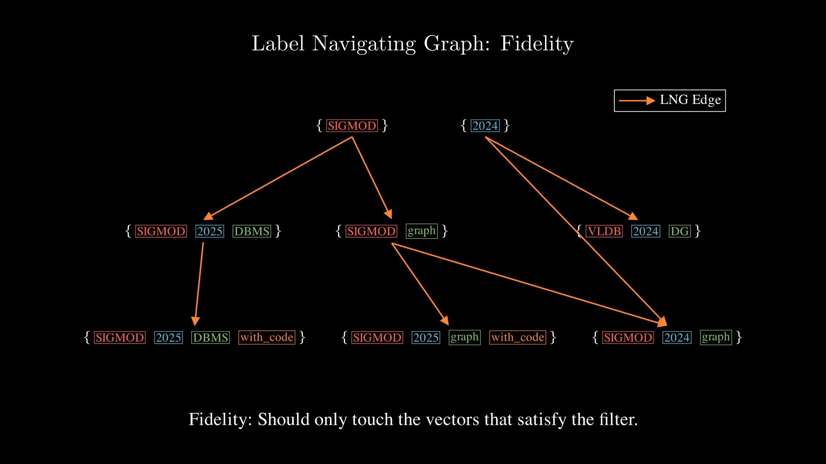
Notes:
For example, if you start the traversal at the label set of only the label venue=SIGMOD.

Slide 30
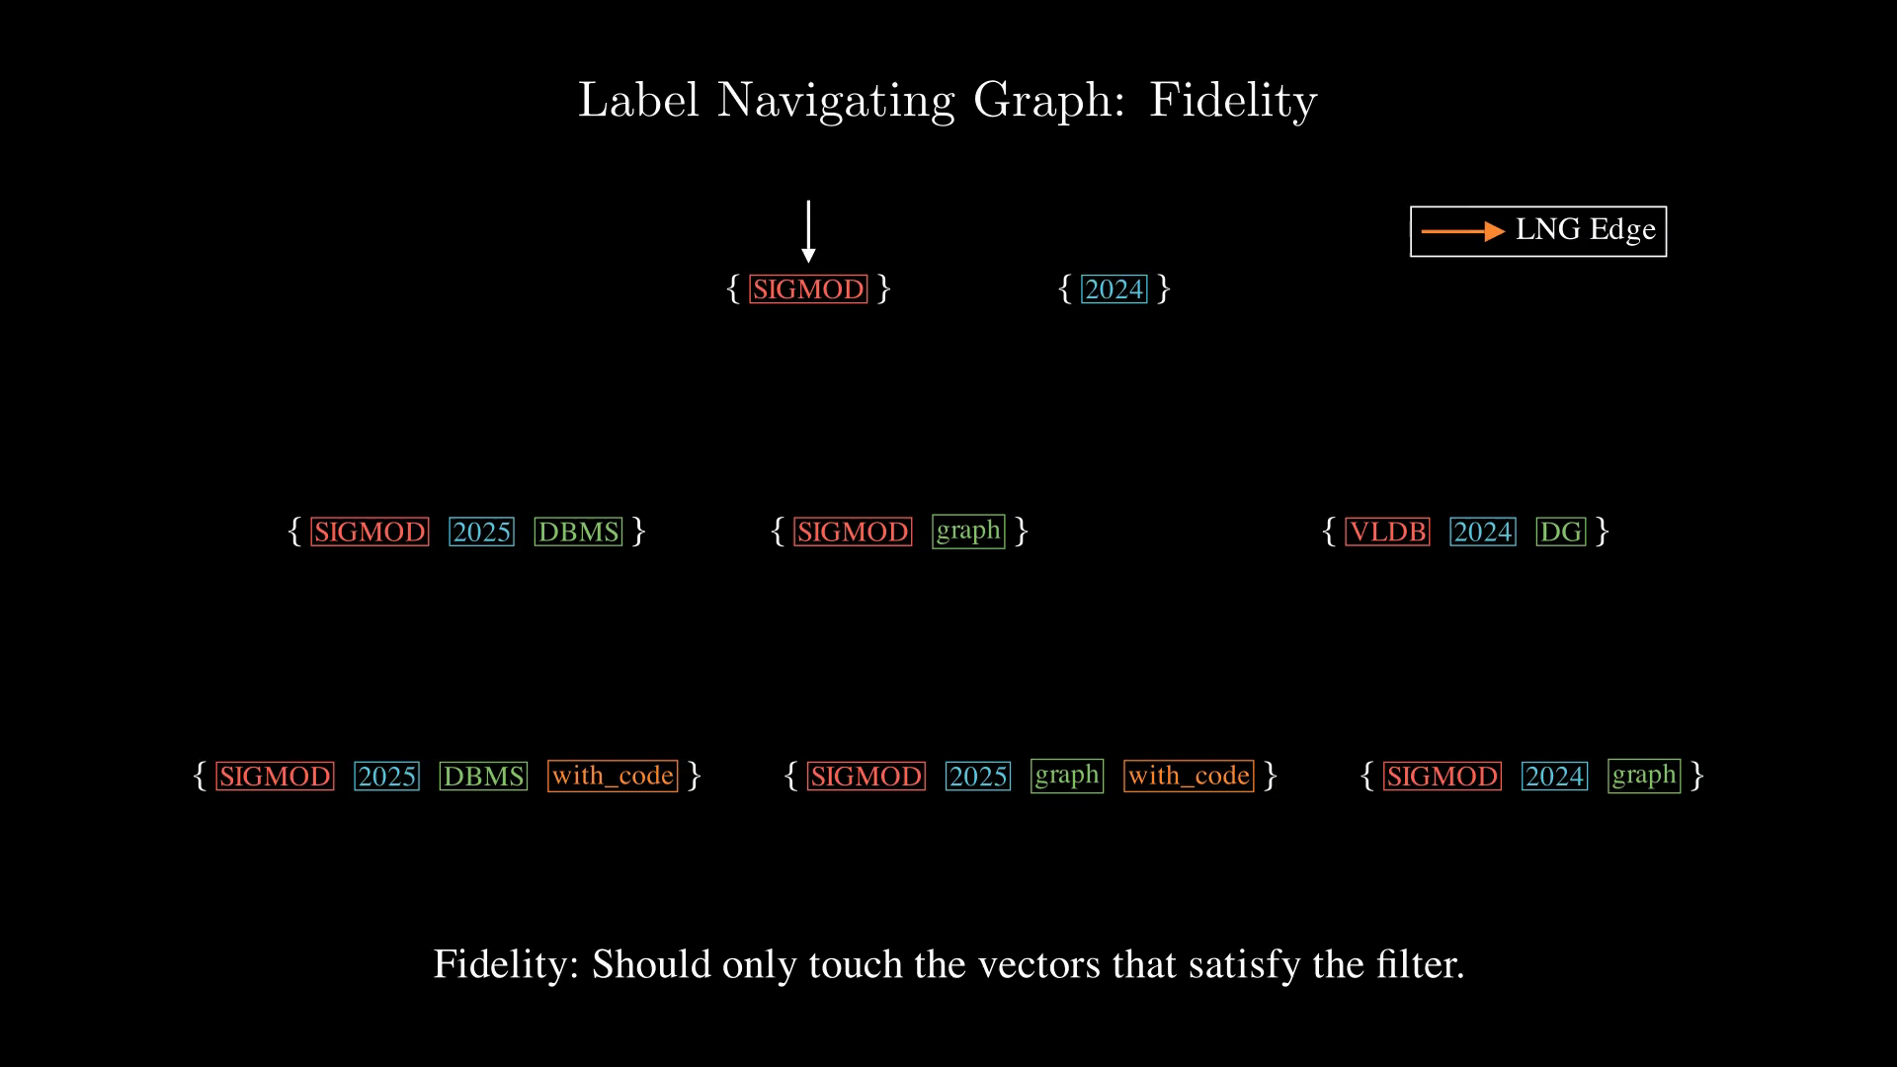
Notes:
All the nodes that you touches satisfy are all supersets of your starting label set. So they all contains the label SIGMOD.

Slide 31
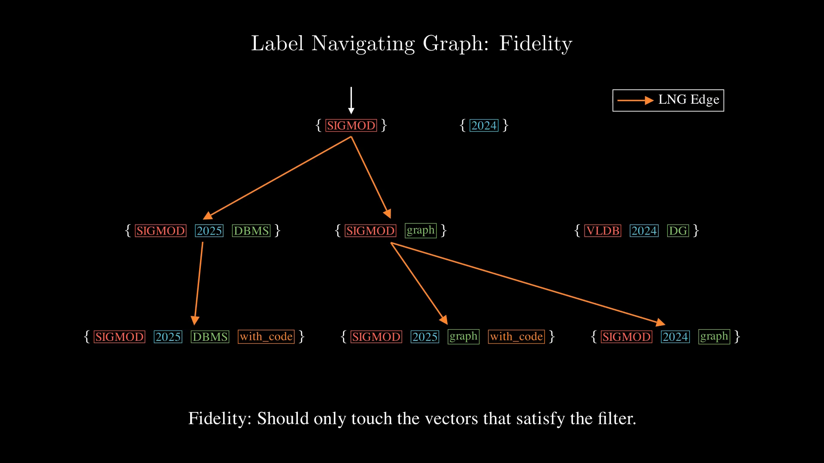
Notes:
All the nodes that you touches satisfy are all supersets of your starting label set. So they all contains the label SIGMOD.

Slide 32
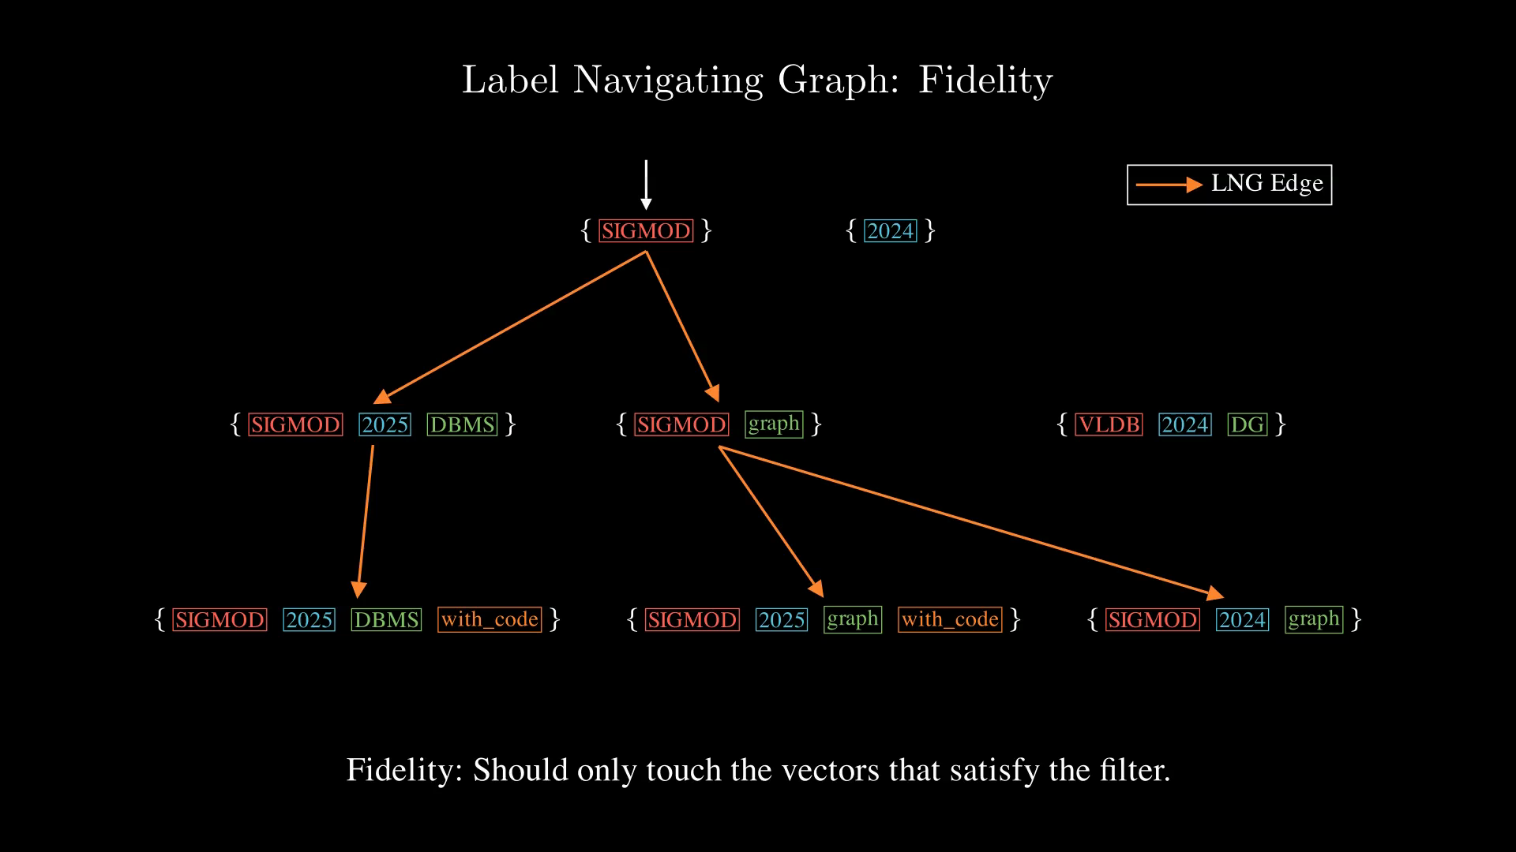
Notes:
Next, let see how shall we incorporate the vectors into this graph.

Slide 33

Notes:
Recall that each label set correspond to a unique set of vectors.
Here are the vectors.

Slide 34
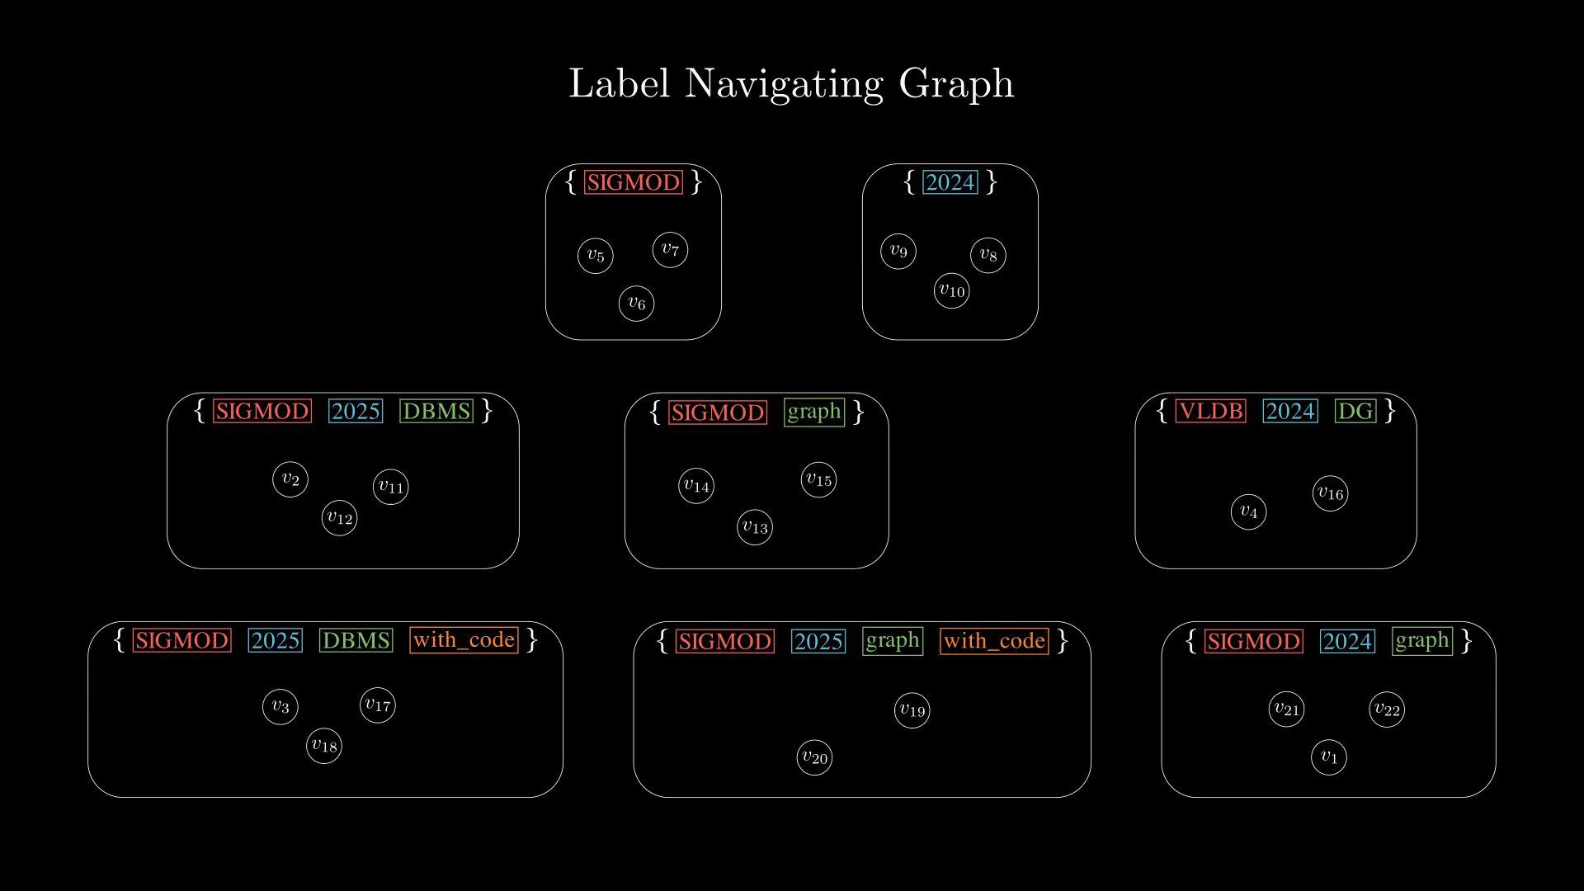
Notes:
For each set of vectors sharing the same label set, we build a proximity-based navigation graph, which can actually follow any graph-based vector index design.

Slide 35
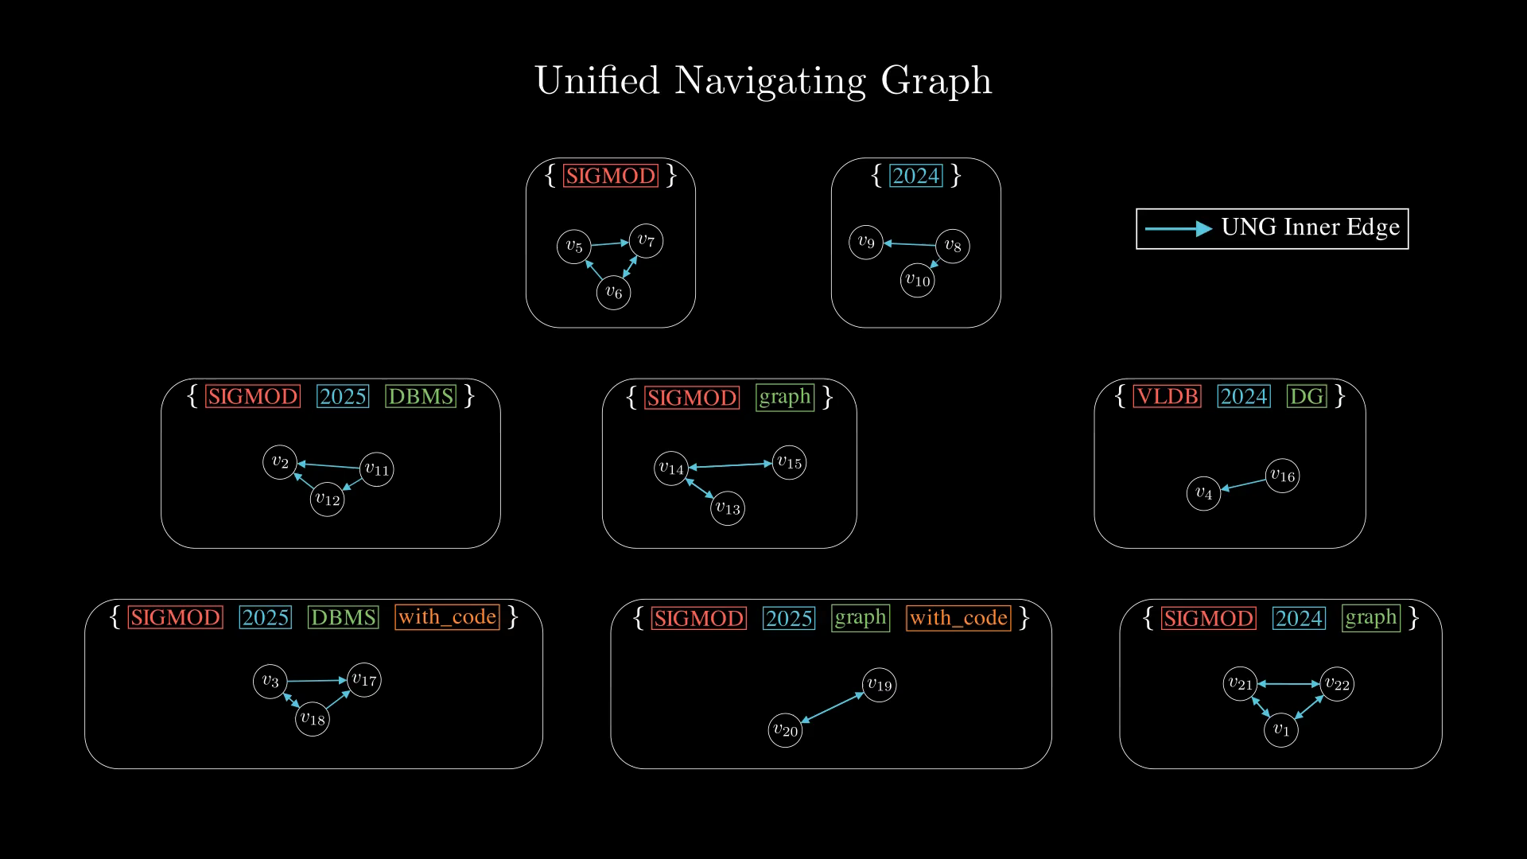
Notes:
Now, each subgraphs itself are connected, let's connect each subgraphs.
Remember the LNG that we built on top of the label set containment relationship? We will use those to connect the subgraphs together.

Slide 36
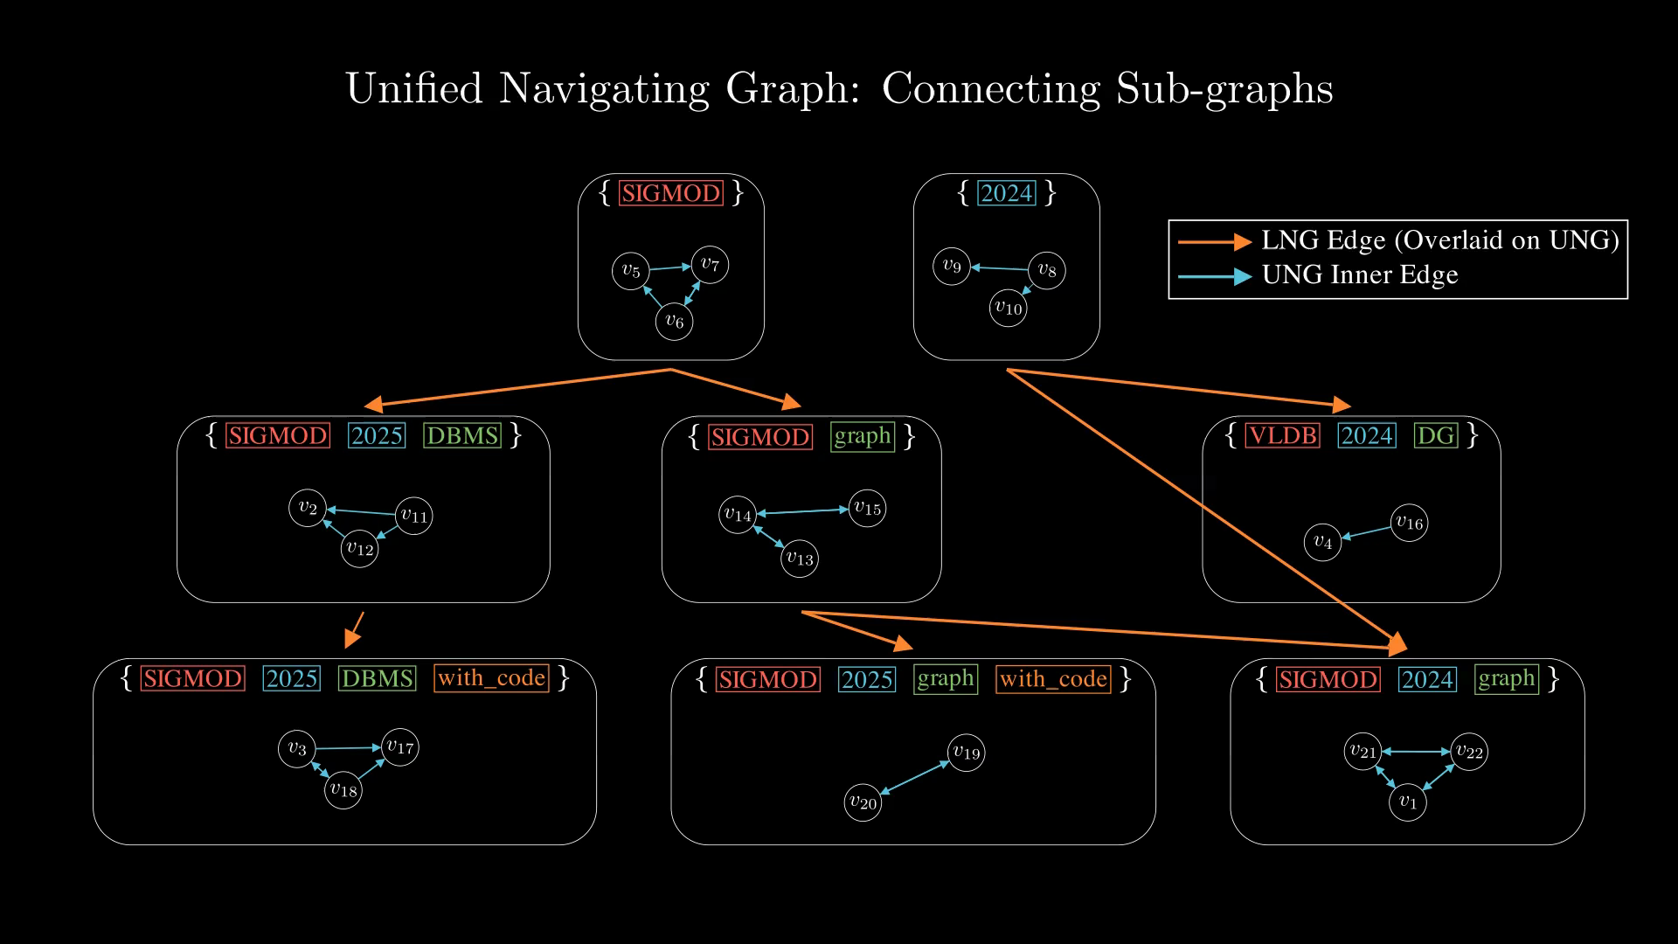
Notes:
The cross group edges are added with these two specific rules...

Slide 37
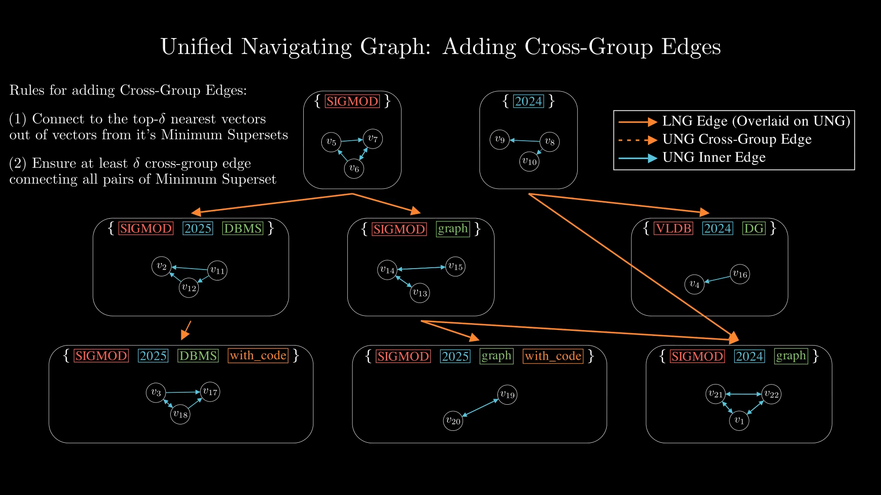
Notes:
The cross group edges are added with these two specific rules...

Slide 38
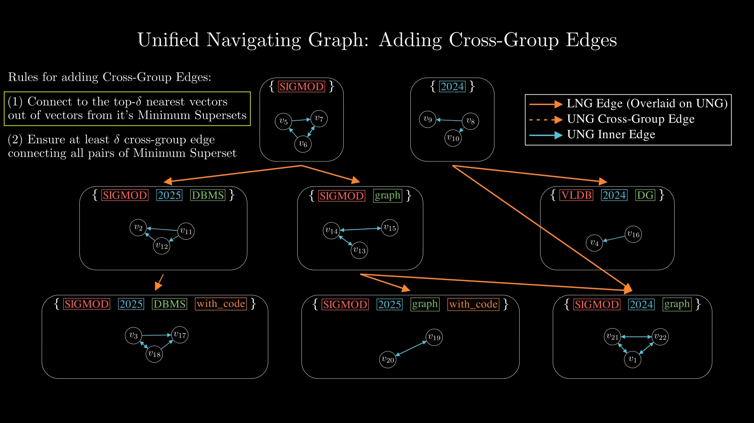
Notes:
The cross group edges are added with these two specific rules...

Slide 39
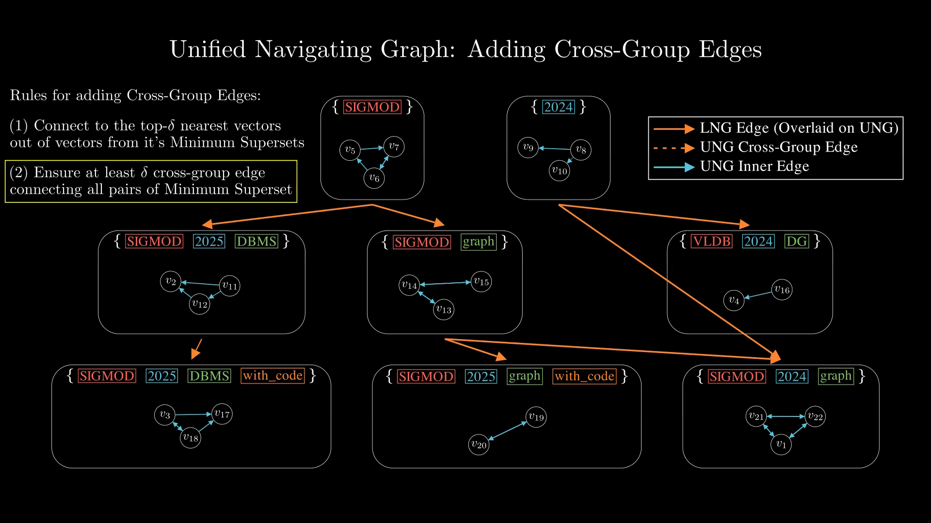
Notes:
Let's zoom in onto this part, and see it in detail.

Slide 40
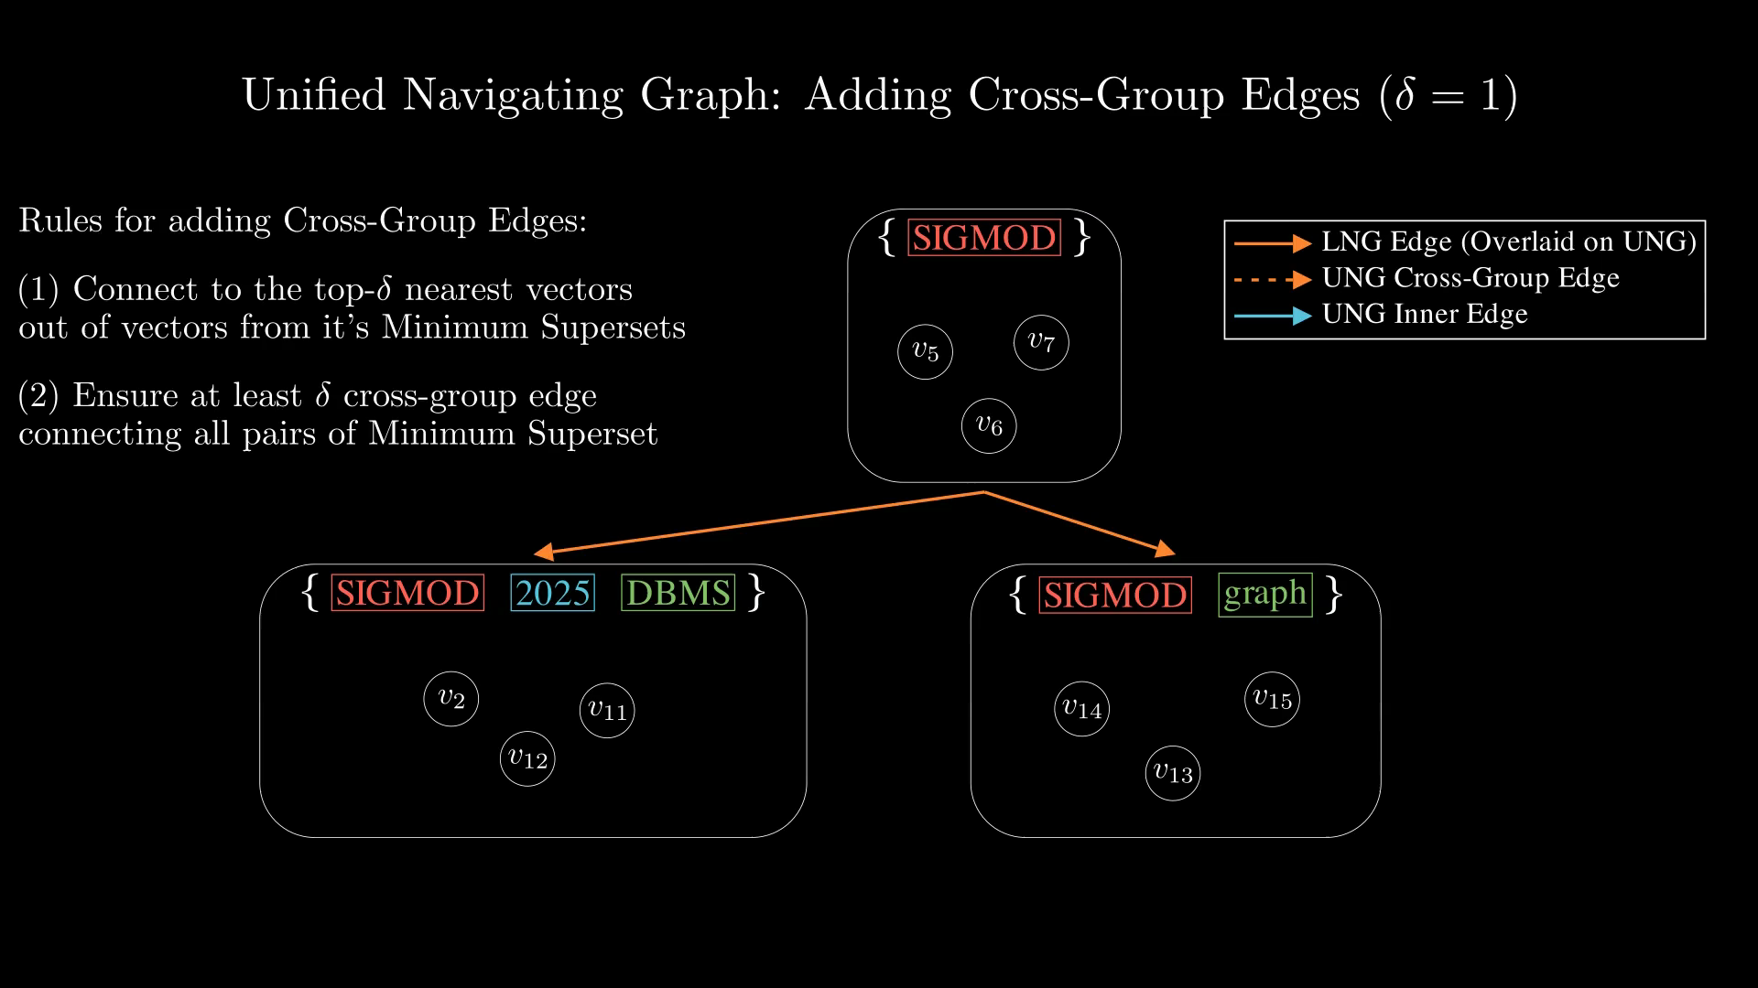
Notes:
Now, according to rule 1, for Delta = 1, we need to pick the nearest one vector (in terms of proximity) from these candidate.
In terms of implementation, since we have a graph index for each subgraph, we can essentially issues KNN queries to find the top-Delta closest vector, and this can be performed parallely, since we are not modifying the subgraph index.

Slide 41
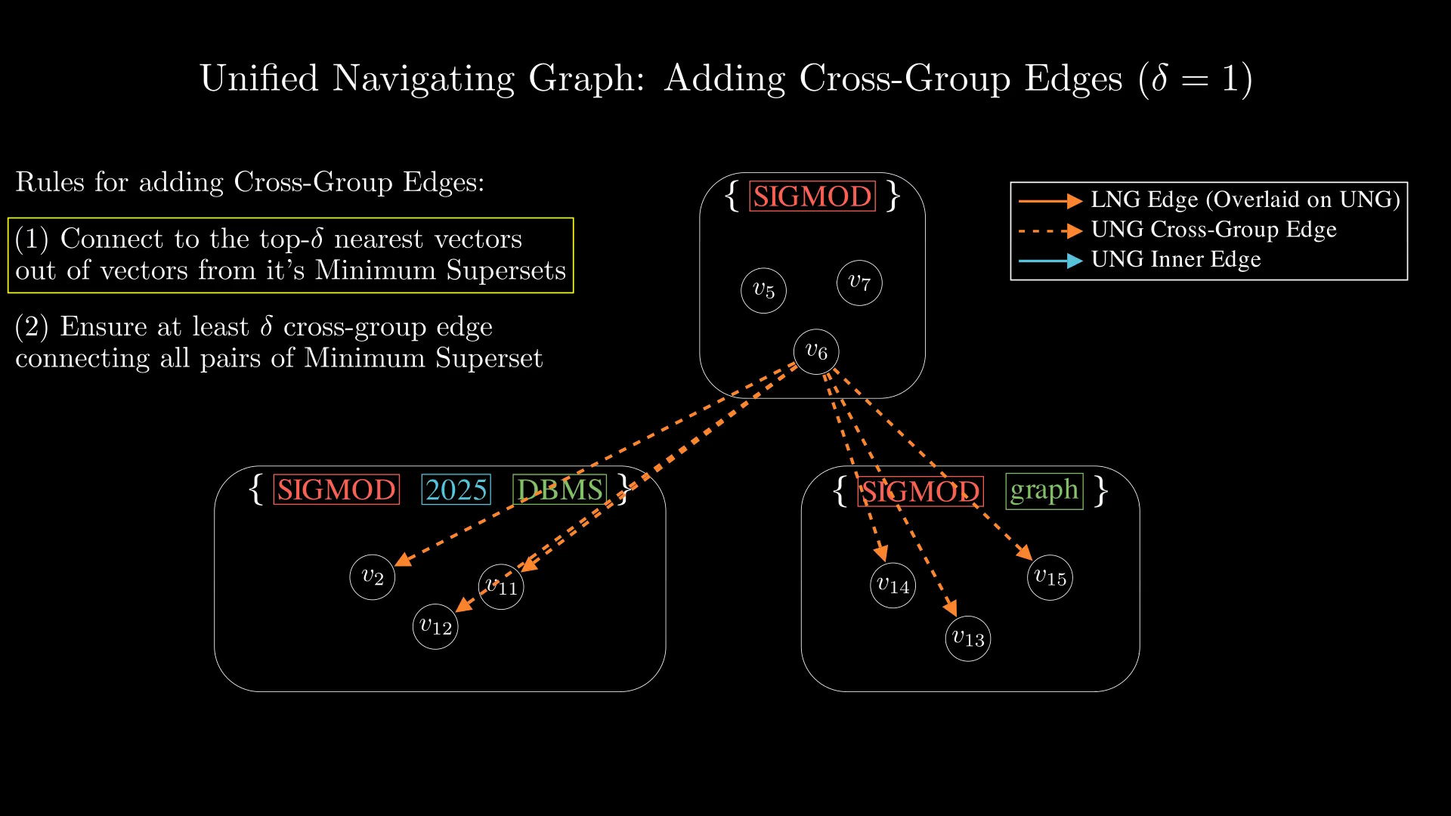
Notes:
This is the closest vector in this example, we simply connect them.

Slide 42

Notes:
This is the closest vector in this example, we simply connect them.

Slide 43
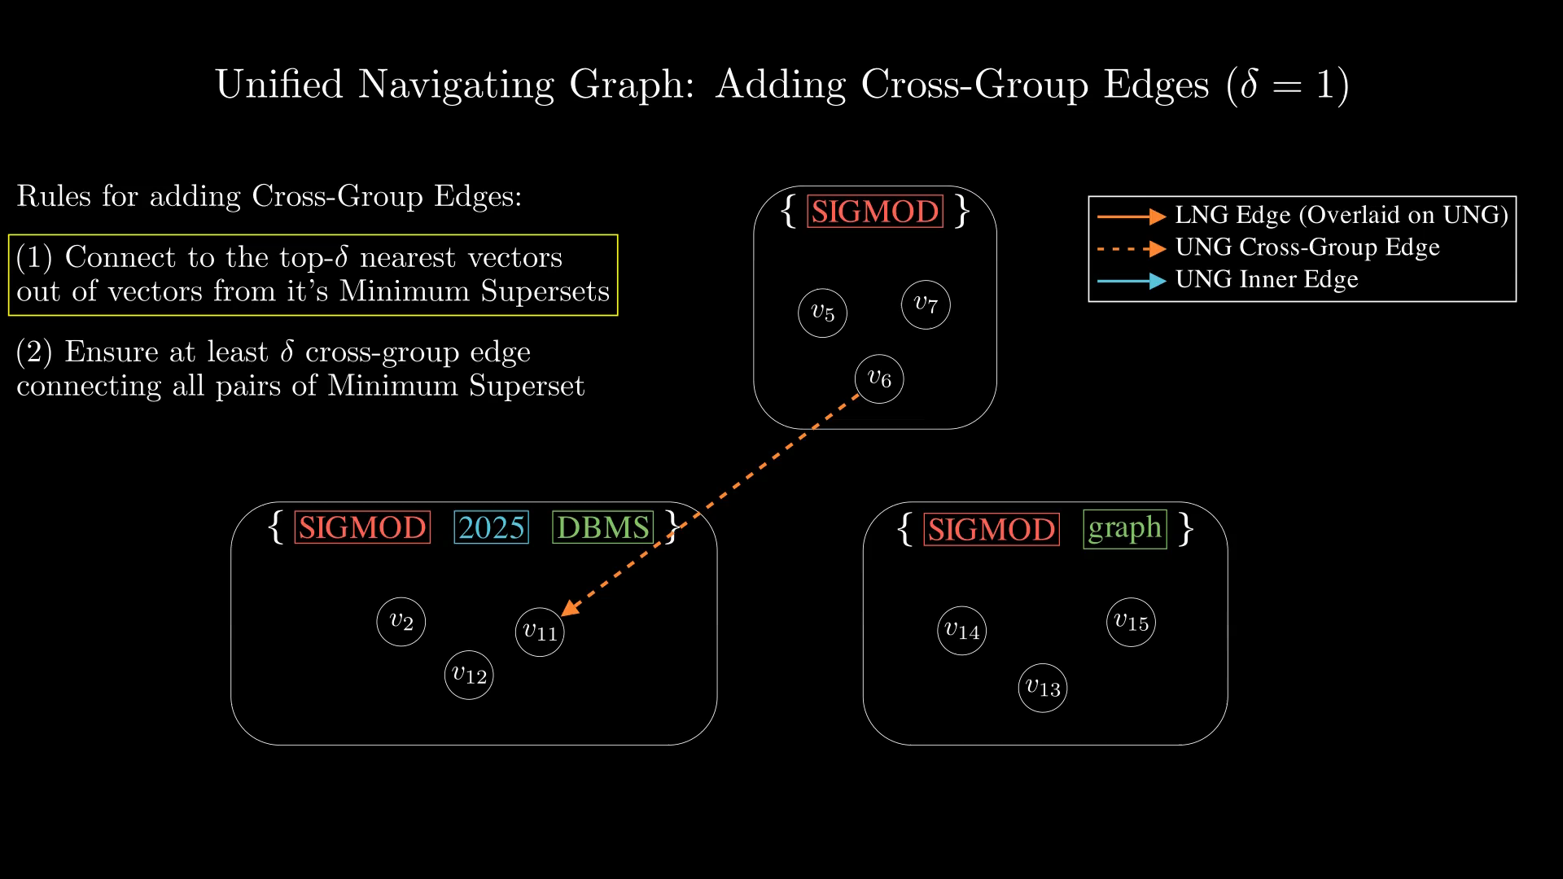
Notes:
Now, according to rule 1, for Delta = 1, we need to pick the nearest one vector (in terms of proximity) from these candidate.
In terms of implementation, since we have a graph index for each subgraph, we can essentially issues KNN queries to find the top-Delta closest vector, and this can be performed parallely, since we are not modifying the subgraph index.

Slide 44
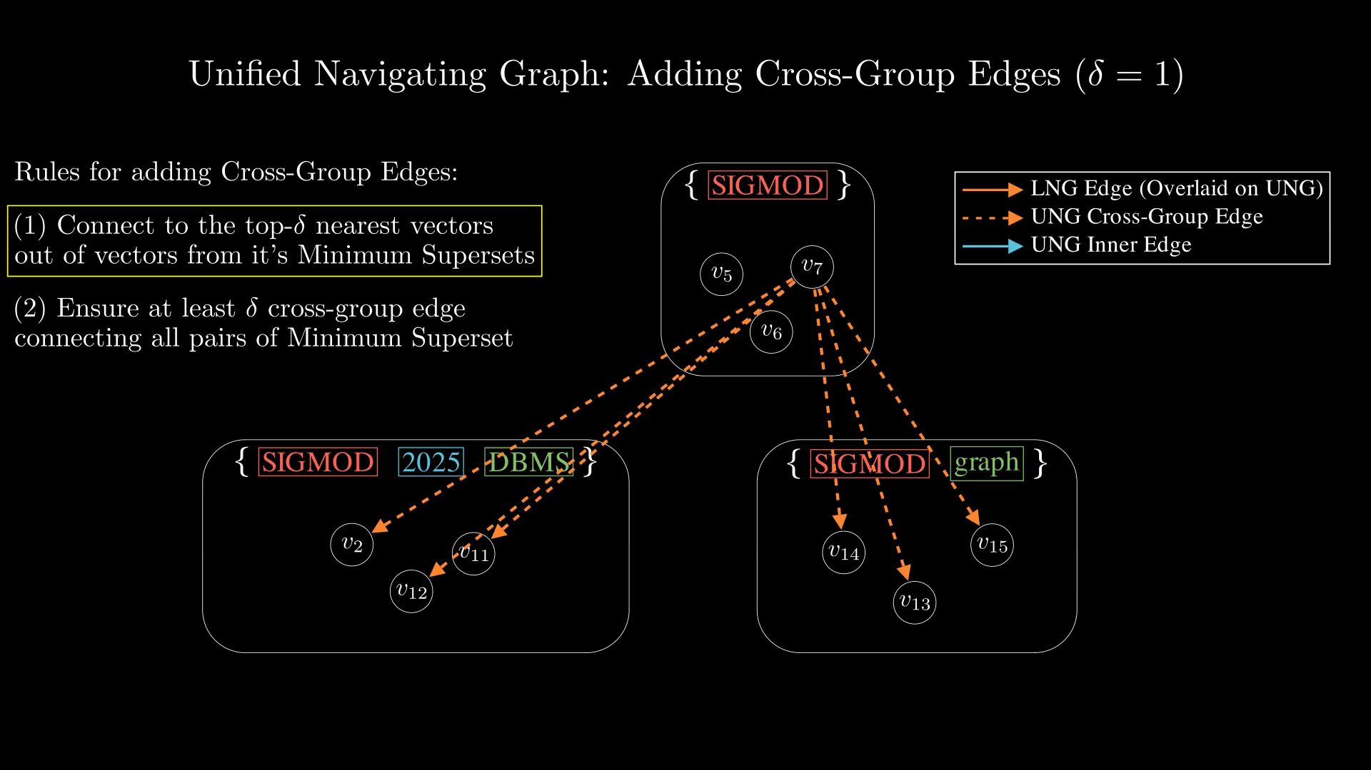
Notes:
This is the closest vector in this example, we simply connect them.

Slide 45
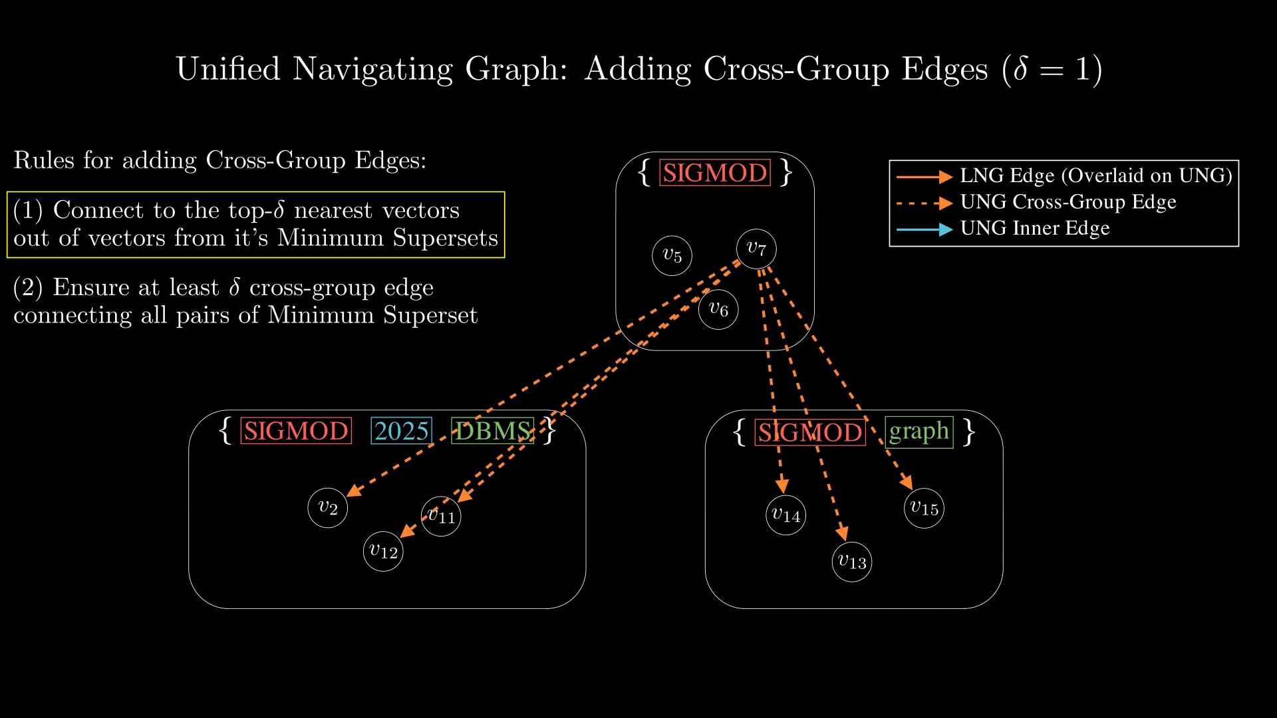
Notes:
This is the closest vector in this example, we simply connect them.

Slide 46
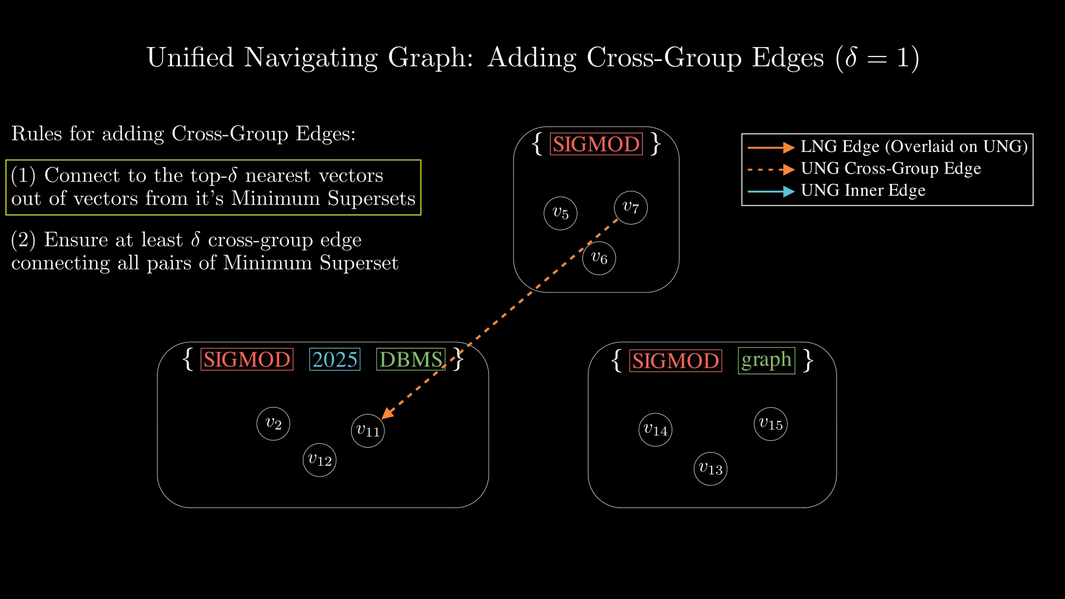
Notes:
Now, according to rule 1, for Delta = 1, we need to pick the nearest one vector (in terms of proximity) from these candidate.
In terms of implementation, since we have a graph index for each subgraph, we can essentially issues KNN queries to find the top-Delta closest vector, and this can be performed parallely, since we are not modifying the subgraph index.

Slide 47
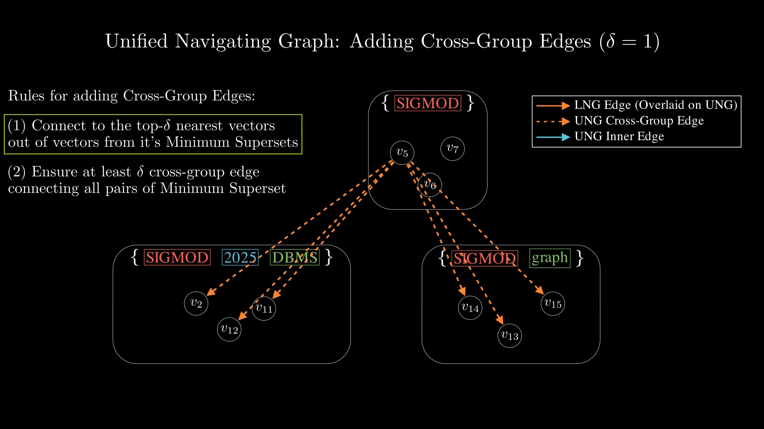
Notes:
This is the closest vector in this example, we simply connect them.

Slide 48
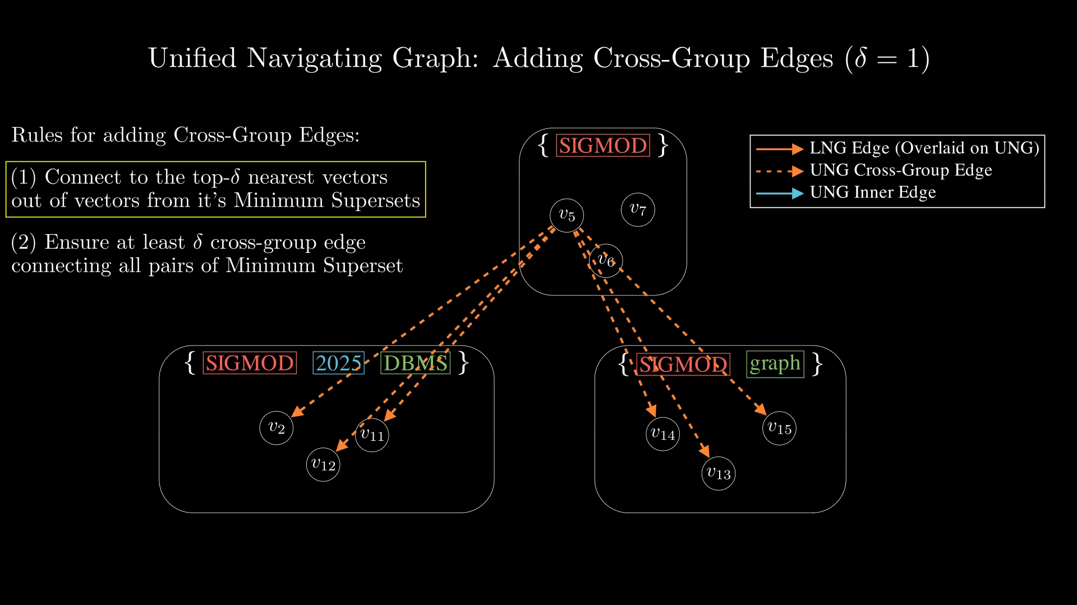
Notes:
This is the closest vector in this example, we simply connect them.

Slide 49
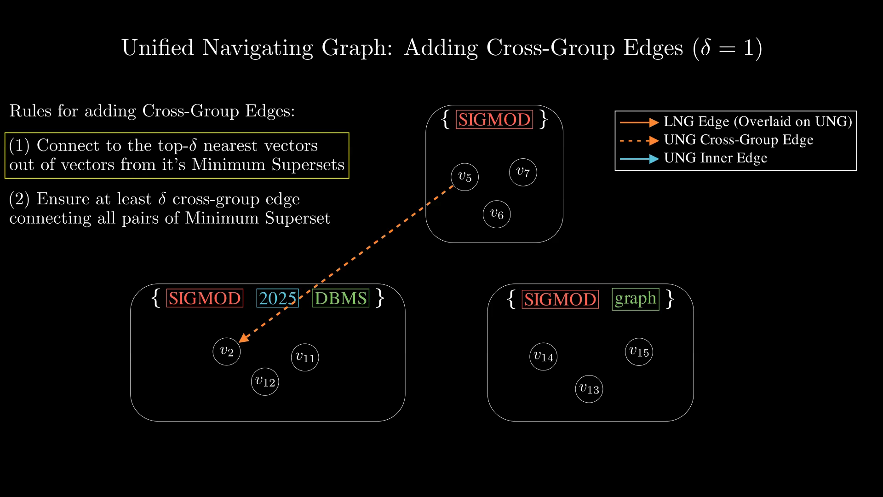
Notes:
Another condition that we need to meet is that: we need to ensure at least one edge are added to each minimum supersets, to ensure connectivity of the unified navigating graph.

Slide 50
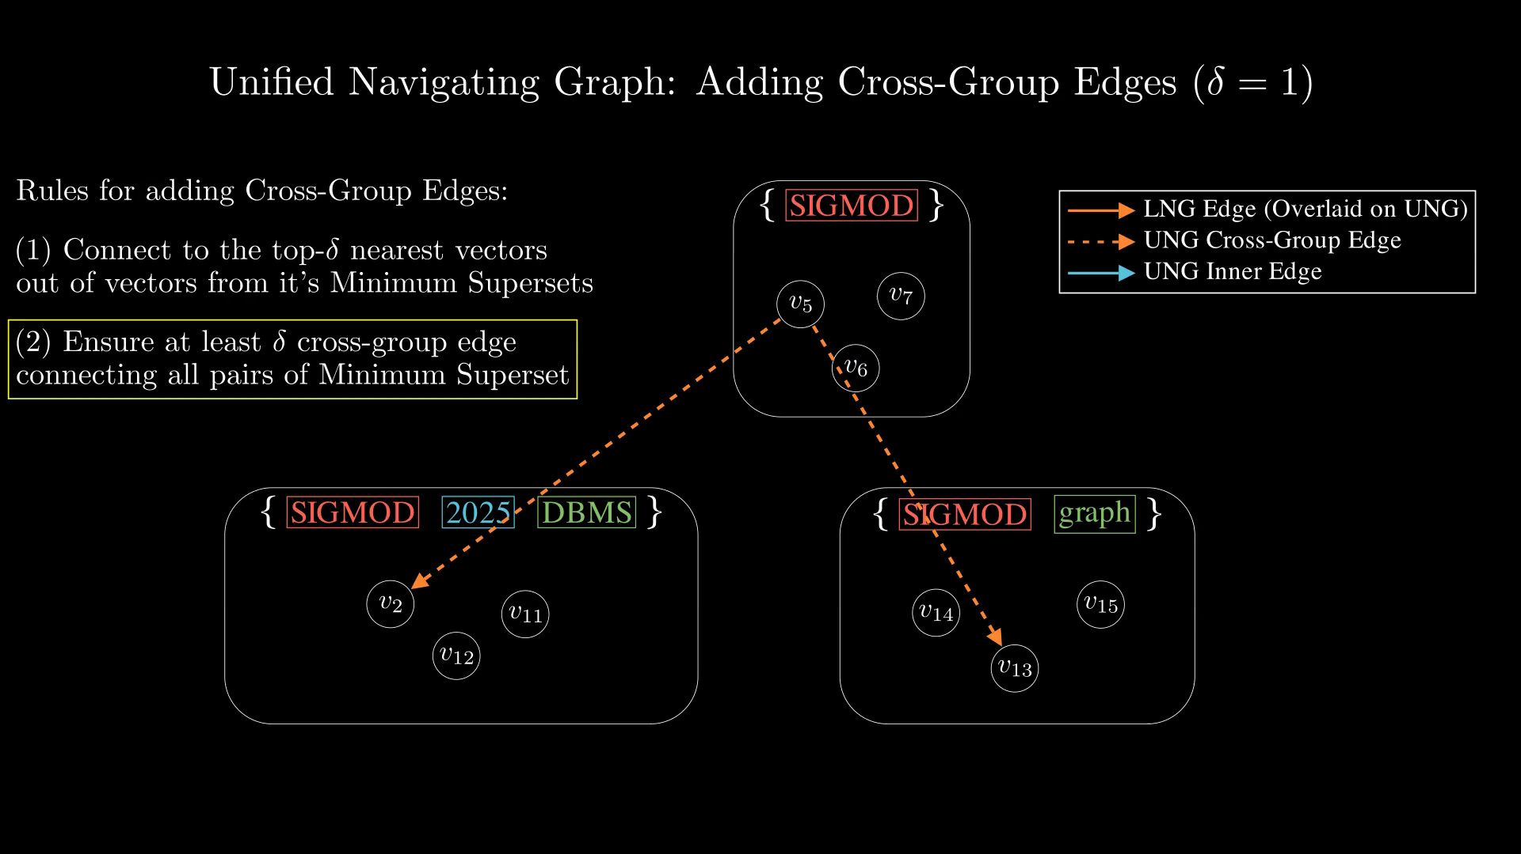
Notes:
So here, we need to add one more edges to ensure rule 2 is valid.

Slide 51
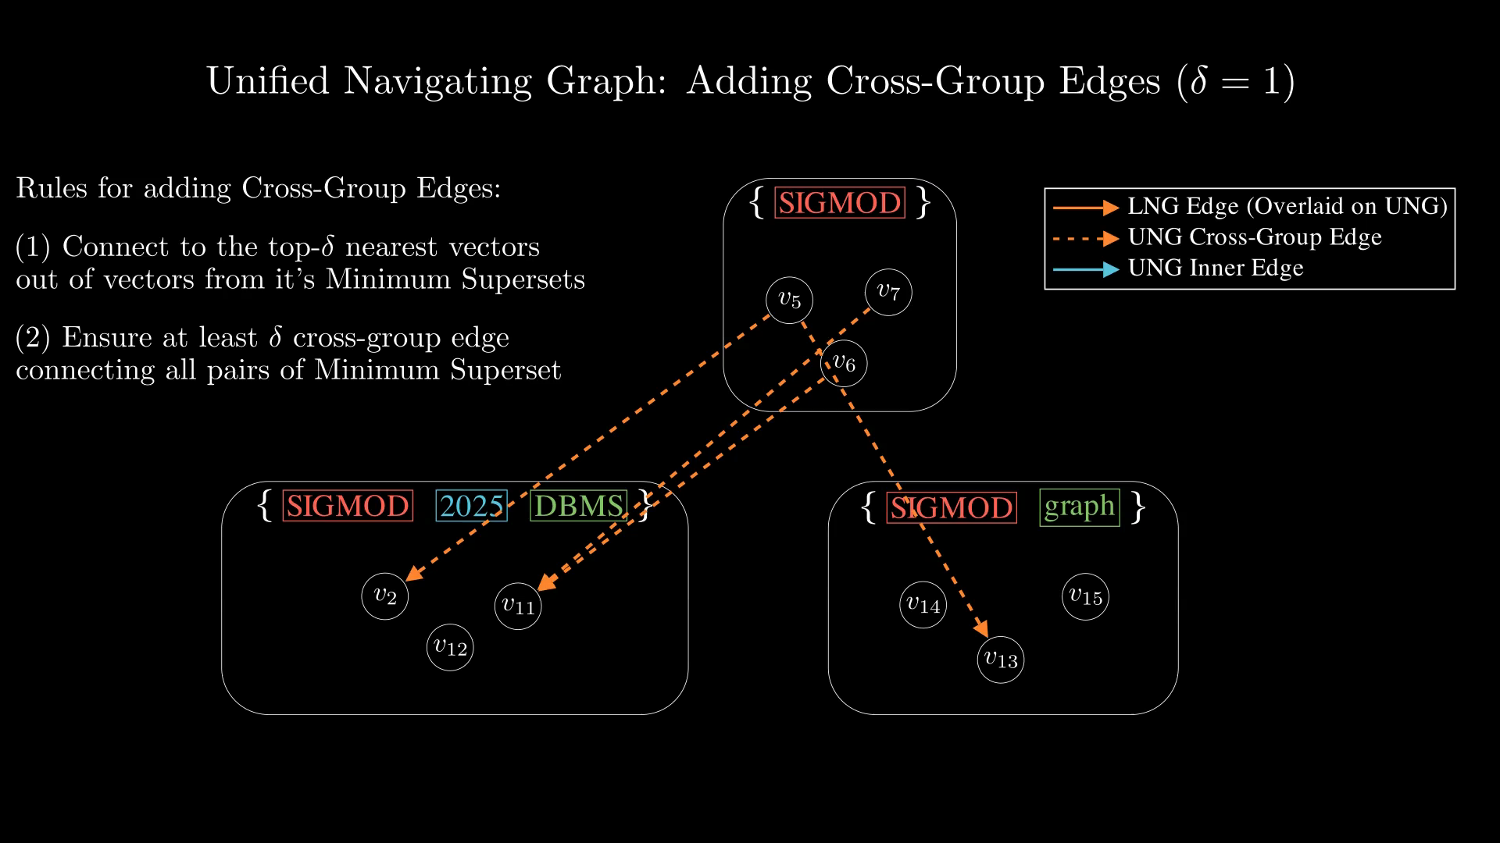
Notes:
Here are the inner edges for each subgraph. And now that's everything we are going to add for this portion of the graph.

Slide 52
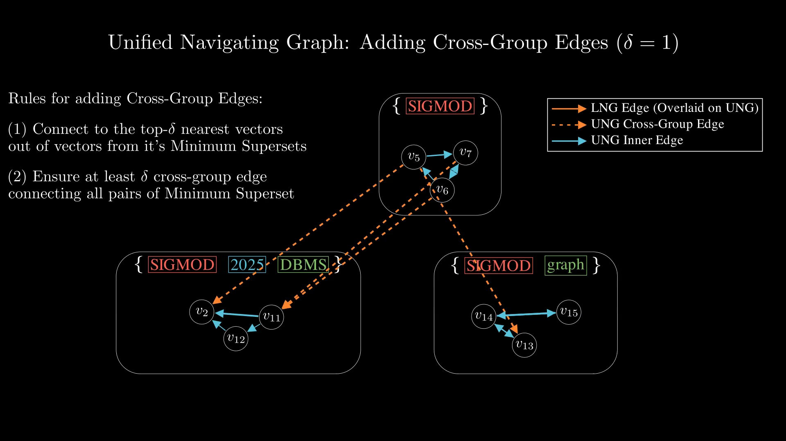
Notes:
Note, the rule 2 ensures that the UNG graph is connected, such that if you start a traversal from a label set, you can eventually reach all it's supersets.
This is related to ensuring the completeness property:
Assuming a subgraph index with good connectivity, meaning you can reach all vectors from the entry vectors.
And since rule 2 ensures that at least Delta cross-group edge is connected between any minimum superset pair, this means we can reach at least Delta nodes in the superset nodes, and so on.
So in the end, you can reach at least Delta vectors, so you can tune the Delta parameter to ensure completeness.
And the paper also mentioned that completeness can typically be archived for Delta smaller than k.
Completeness is proven more rigorously in the paper.

Slide 53
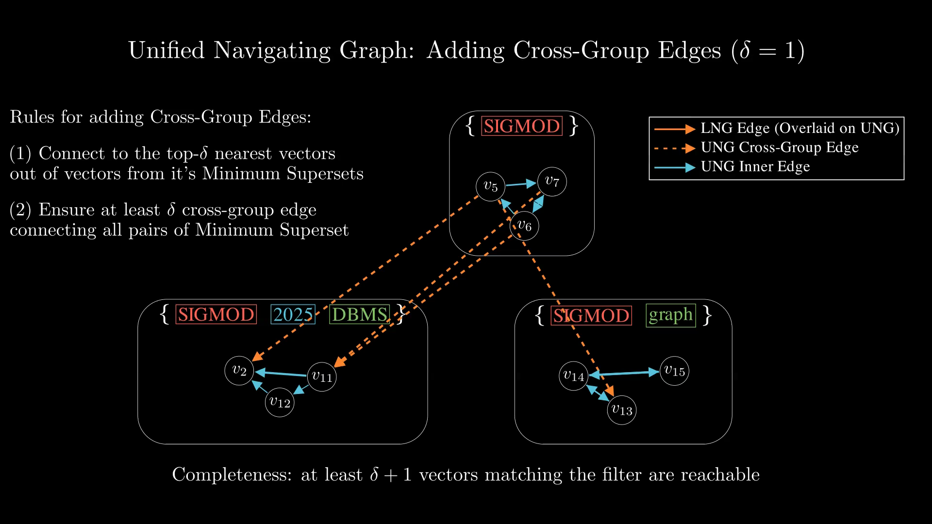
Notes:
Let's overlay everything into one picture.

Slide 54

Notes:
Next, let's look at how to perform query.

Slide 55

Notes:
Suppose we have a filtered ANNS query like this...

Slide 56

Notes:
Let's represent the filter condition as labels.

Slide 57

Notes:
Notice, the label set abstraction provides versatility on the query filter, where any size and combination of the attributes can be represented.

Slide 58

Notes:
Next, let's see how do we process the such query, with the label set as the filter.
First step is to find something called the "Entry Sets", which is where we should start the graph search.
Intuitively, we should start at those that satisfies the filter, which are just the supersets of the query label sets.

Slide 59

Notes:
There are two cases in finding the entry set.
Case 1 is the trivial case, which the query set directly matches one of the label set in LNG.
In this case, we can directly start from that set.
Case 2 is a bit more complicated.

Slide 60

Notes:
Trivially, handling case 2 would just require us to use all superset.
However, that may be too much.
We can start from the minimum supersets of the query label set, all supersets are reachable by traversing the cross-group edge.
The paper introduces a method using Trie + Inverted List to efficiently find the minimum superset of any query label set.

Slide 61

Notes:
And for this particular example, the entry set is ...

Slide 62

Notes:
The next step is just to perform the greedy best first search from all nodes in the entry set's graph.

Slide 63

Notes:
We just follow the standard best-first search using the distance heuristic.
We start by populating the queue with entry vectors from the entry sets's subgraph index.
We select randomly, Sigma of them.
Then, each time, we pop the best vector based on the heuristic, and push all it's out-edges.
We also only keep the best W candidate to keep the search queue short.
Note that, the cross-group edges are also in the out-neighbour's list, so during this step,we are exploring other partitions' graph, through these edge.
Lastly, the greedy search stops when all W candidate are explored.

Slide 64

Notes:
We just follow the standard best-first search using the distance heuristic.
We start by populating the queue with entry vectors from the entry sets's subgraph index.
We select randomly, Sigma of them.
Then, each time, we pop the best vector based on the heuristic, and push all it's out-edges.
We also only keep the best W candidate to keep the search queue short.
Note that, the cross-group edges are also in the out-neighbour's list, so during this step,we are exploring other partitions' graph, through these edge.
Lastly, the greedy search stops when all W candidate are explored.

Slide 65

Notes:
We just follow the standard best-first search using the distance heuristic.
We start by populating the queue with entry vectors from the entry sets's subgraph index.
We select randomly, Sigma of them.
Then, each time, we pop the best vector based on the heuristic, and push all it's out-edges.
We also only keep the best W candidate to keep the search queue short.
Note that, the cross-group edges are also in the out-neighbour's list, so during this step,we are exploring other partitions' graph, through these edge.
Lastly, the greedy search stops when all W candidate are explored.

Slide 66

Notes:
Let's see an example...

Slide 67

Notes:
Here are the entry sets.

Slide 68

Notes:
Here are the selected entry vectors.

Slide 69

Notes:
Let's next see an example

Slide 70


Slide 71


Slide 72


Slide 73


